Slide 1

2026 Professional Development Series:
Corrections Windows
Overview
Accountability Coordinators, District Testing Coordinators, Assessment Proxies, and PowerSchool Administrators
Vann Holden, PhD, Era Roberts, EdD, Wendy Stephens
May 2026
Notes:
Slide title should be Aptos Bold font, left-aligned, not smaller than 44pt
Audience – To whom/group you are presenting to
Speaker – Who is giving the presentation (may be by name or by department)
Date – Date of presentation

Slide 2
Agenda
Why corrections?
When will corrections occur?
What will be corrected?
How are corrections to be submitted?
What happens after the corrections are submitted?
How do districts know if the corrections were approved?
Planning Time
Next Steps
Notes:
Left aligned
Title font is 88pt
Numbered line item 66 pt
Detail/slide item 36 pt

Slide 3
Accountability & State Report Card Mission
To redesign and sustain South Carolina’s accountability system and School Report Card so that it clearly defines excellence, measures what matters, and provides families, educators, and policymakers with actionable, easy-to-understand information that drives improvement for students.
EDUCATION OVERSIGHT COMMITTEE | DEPARTMENT OF EDUCATION

Slide 4
Goals
Goal 1: Accountability
Define what excellence looks like and measure what matters.
Align accountability measures to meaningful student outcomes.
Ensure ratings are clear, fair, and easy to understand.
Use results to drive actionable improvement, not just compliance.
Goal 2: Reporting & Analytics
Communicate clear, timely, and useful information to families, educators, and policymakers.
Create intuitive School Report Cards with trend data and context.
Develop metrics, calculations, visualizations, and web reporting that clarify, not complicate.
Provide clear guidance so users can interpret results and take action.
Goal 3: Data Collection & Quality
Strengthen the systems, processes, and tools that power the work.
Optimize data collection and modernize data flow (Data sources → Ed-Fi → GPS → Report Card) through coordinated processes and IT support and strong collaboration across IT, districts, and data partners.
Integrate calculations into GPS for pre-accountability dashboards.
Improve understanding of requirements, processes, and deadlines.
EDUCATION OVERSIGHT COMMITTEE | DEPARTMENT OF EDUCATION

Slide 5
Goal 3: Data Collection & Quality
Strengthen the systems, processes, and tools that power the work.
Optimize data collection and modernize data flow (Data sources → Ed-Fi → GPS → Report Card) through coordinated processes and IT support and strong collaboration across IT, districts, and data partners.
Integrate calculations into GPS for pre-accountability dashboards.
Improve understanding of requirements, processes, and deadlines.
EDUCATION OVERSIGHT COMMITTEE | DEPARTMENT OF EDUCATION

Slide 6
Corrections Window
Notes:
Wendy

Slide 7
Professional Development & Preparation
Professional Development
  Data Corrections – Overview of Summer 2026 Process
    May 20 at 1 PM and May 21 at 9 AM
  Data Corrections – Specific Forms, Templates, and Procedures
    June 17 at 1 PM and June 18 at 9 AM
Please be aware that this process will begin after July 1, and this is one of the reasons it is essential that districts have a plan to ensure continuity of accountability work through the summer and October release of the report cards.
Notes:
Marie

Slide 8
Corrections window: Current state
Key info:
  We are currently in the primary correction window! If you see data that is incorrect in Admin Navigator, this is the time to correct it.
  Use Admin Navigator to view and verify 9GR cohorts, similar to prior use of base files. Admin Navigator can also be used to verify test score data for CCR.
  SCDE will shift from Admin Navigator to static student-level report card files this summer. We intend for this to be the final year of static student-level files.
Notes:
Wendy

Slide 9
Key Dates Prior to Corrections
Window | District Deadline | SCDE Collects
PowerSchool Data Collection Closes | Submissions complete by June 14, 7pm | June 15
Assessment Data Collection Closes | Submissions complete by July 31, 7pm | August 1
Summer Graduation Data Collection Closes | Submissions complete by August 16, 7pm | August 17
  Ed-Fi data submission guidance can be found here:
  Ed-Fi data submission guidance
  This hub currently has end-of-year (EOY) guidance for PowerSchool-to-Ed-Fi data submissions due June 14 at 7:00 p.m. (first row in the chart above); guidance will be added for the other deadlines, as well.
Notes:
Wendy

Slide 10
Three Distinct Corrections Windows
Window | Purpose | District Submission | SCDE Review | Updated Release
Denominator | Verify student inclusion eligibility | July 13–17 | July 20–31 | Updated file provided in ADT: Week of August 3
Numerator | Verify student outcomes/results | Aug. 31–Sept. 4 | Sept. 8–21 | Updated file provided in ADT: Week of September 21
Preliminary Ratings | Review preliminary ratings posted to embargo site | Sept. 28–30 | Final validation | Updated to embargo site: October 1
  Bottom line: Each window is distinct and serves a specific role in ensuring accurate accountability reporting.
Notes:
Wendy

Slide 11
What makes data a part of the denominator?
The denominator in this context refers to the total number of students that are eligible to be counted in the metric's calculation. It is a critical component that ensures the accuracy and fairness of the metrics reported in the school report card.
The decision to include a student in the denominator is based on predefined criteria that are strictly adhered to, ensuring consistency across all metrics.
It is important to note that this review does not encompass the actual values earned by the students for the metrics. The focus here is solely on the inclusion criteria, which are instrumental in shaping the denominator.
Denominator does not review test scores, credit or diploma outcomes, points earned, or ratings.
Key Process: Student Record → Eligibility Rules Applied → Included / Not Included

Slide 12
What makes data a part of the numerator?
The numerator references the students’ outcomes related to each metric. These include outcomes such as test score, credits, and diplomas earned.
The values earned from student outcomes are based on predefined criteria that are strictly adhered to, ensuring consistency across all metrics.
It is important to note that this review builds off the denominator corrections. Students finalized to the denominator will be the data set to apply numerator outcomes. Corrections will only be applied to the student outcomes.
Key Process: Student Outcome → Values Applied → Exclusion Applied → Metric Calculation

Slide 13
Denominator vs. Numerator Review
Denominator Review | Numerator Review
Who should be included? | What outcome did the student earn?
Key Features
Continuous enrollment | Outcome verification
Course enrollment | Test scores
Cohort inclusion | Credits earned
ML eligibility | Diplomas earned
Participation inclusion | Exclusions applied
Key Clarification
Denominator = inclusion
Numerator = outcome

Slide 14
What do I expect for preliminary ratings review?
The denominator (eligibility) and numerator (values) have been set.
The rating outcomes are based on predefined criteria that are strictly adhered to, ensuring consistency across all metrics.
Ratings review allows districts to review preliminary metric outcomes posted to embargo site.
Corrections for this window emphasize possible errors in the calculations of the already determined values.
Key Process: Metric calculation review

Slide 15
Putting the three processes together
Denominator Review
Numerator Review
Metric Review
Key Process: Student Record → Eligibility Rules Applied → Included / Not Included
Key Process: Student Outcome → Values Applied → Exclusion Applied → Metric Calculation
Key Process: Metric calculation review

Slide 16
Corrections Process
Notes:
Wendy

Slide 17
Corrections Submission Process
District receives files in ADT
District completes corrections template
District verifies supporting documentation
District reviews student records
District uploads corrections template and plan to ADT
SCDE reviews request
District completes corrections plan
District submits SolarWinds ticket
Updated files distributed to ADT
Notes:
Wendy

Slide 18
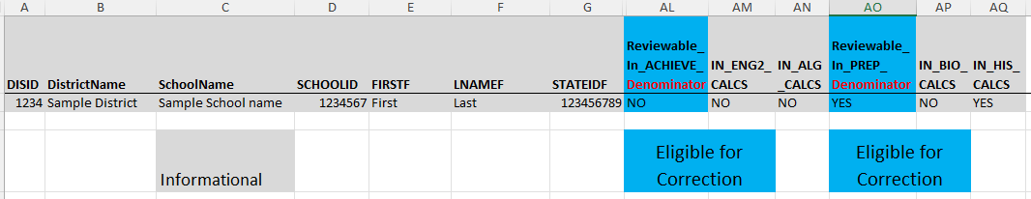
District file review
The file will:
Be familiar, student-level files
Include consistent column headers
Be distributed through ADT
Include specific review and verification indicators
Sample Denominator File Headers: HSAAPS
Notes:
Wendy

Slide 19
District Submissions
  A SolarWinds ticket alerts SCDE to corrections submission and provides a clear communication channel for SCDE review and district progress update.
  2 main deliverables:
    An accurately completed and renamed corrections template (naming convention will be provided)
    A corrections plan reviewing steps to be taken by the district to resolve the issue, when applicable.
  ADT is the collection source for deliverables due to PII.
  Districts are to ensure proper documentation for the requested correction exists, but this will not be submitted unless specifically requested.
  Professional development sessions, key resources, and the accountability manual may all be used to support a deeper understanding of inclusion in metric denominator (window 1), numerator (window 2), and ratings calculations (window 3).
Important Note: Detailed technical guidance and file specifications will be reviewed during June procedures sessions.
Notes:
Wendy

Slide 20
SCDE Review
  SolarWinds ticket begins the process with SCDE for the correction request.
    This is the primary communications channel for your request.
  A corrections review team will review district submissions.
  Ticket will be resolved in SolarWinds with feedback to the district.
  Approved submissions will be processed for coding updates.
  Updated files produced to ADT as listed in key dates table.
Notes:
Wendy

Slide 21
Process Responsibility
  Superintendents will receive a form to indicate who the designee for correction is following the May 21 professional development session.
  In addition to the normal invite list, the designee will be invited to the June sessions.
  Districts with accountability-related position changes occurring over the summer should plan for knowledge transfer now.
  The person indicated as designee should be actively working for the district for the duration of the corrections period.
  The designee is the district’s primary point of contact for corrections.
Notes:
Wendy

Slide 22
Housekeeping
Notes:
Agenda is 88 pt
Line item is 66 pt

Slide 23
Summer Graduates – 9GR23
Diplomas earned by summer graduates are to be coded in PowerSchool by the third Monday in August
  District loads to PowerSchool by August 16, 2026
  Arrives to SCDE by August 17, 2026
Remember that this is ONLY for summer graduates – all other graduates must be coded by the June 14 deadline!
Follow the same guidance for coding graduates provided in the Graduation Rate and HSSSI

Slide 24
On-Track and CCR Dashboard
Combining some key ideas from the PD series:
  Use Admin Navigator to view and verify 9GR cohorts, similar to prior use of base files.
  Admin Navigator should also be used to view and verify test score data for CCR. Several of these assessment are to be loaded by the district.
    See details on the assessment loading to Ed-Fi site
  SCDE will shift from Admin Navigator to static student-level report card files this summer. We intend for this to be the final year of static student-level files.

Slide 25
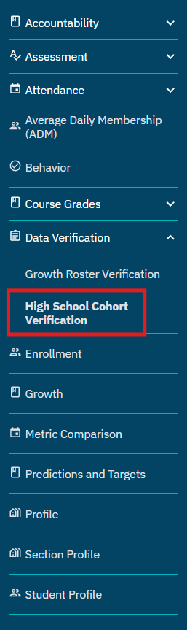
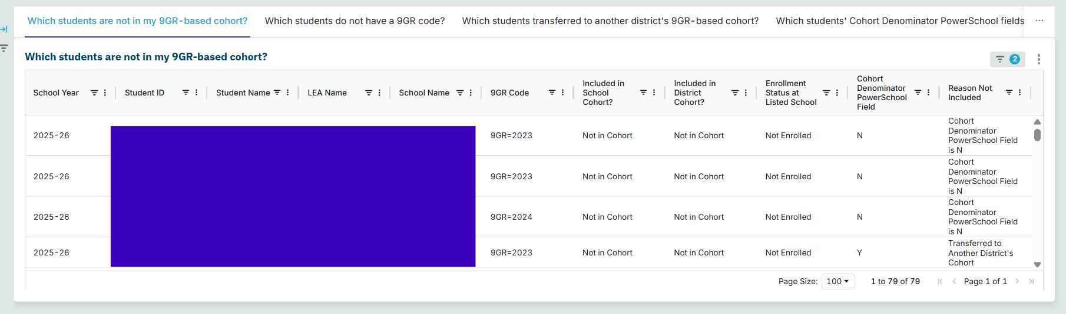
Cohort Verification Dashboard
The dashboard is a valuable tool created in response to district user feedback.
The May 11th and May 18th EA Office Hours reviewed the features of this tool.
  Review all past recordings and notes: Google Drive Folder.
To attend future EA Office Hours, you only need to register - registration can be found here.

Slide 26
Planning Time
Notes:
Agenda is 88 pt
Line item is 66 pt

Slide 27
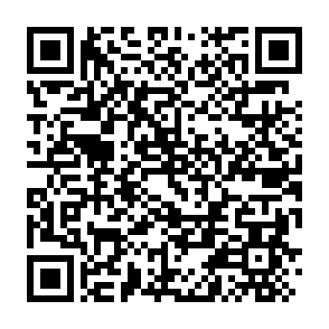
Session Evaluation
Please complete an evaluation of the session using the QR Code.
Notes:
Header font 50pt
Content/body text font 28pt

Slide 28
Planning Time: Key Concepts
We have covered a lot of information today:
  Progress toward supporting accurate 25-26 data
  Timeline for corrections windows
  Processes to submit corrections
  What to expect after submission
This means you have a lot of information to plan for, act on and communicate.
Notes:
Header font 50pt
Content/body text font 28pt

Slide 29
Planning Time: Key Questions
Questions | Priority 1 | Priority 2 | Priority 3
What needs to be communicated?
Who is the audience?
How does it need to be communicated?
When does it need to be communicated?
How do you plan to follow up to ensure implementation is occurring?
Notes:
Header font 50pt
Content/body text font 28pt

Slide 30
Next Steps
Final session coming in June
We plan to distribute event links about one week prior to the sessions.
  Topic 6: Corrections Window Procedures
    June 17 (1pm) and June 18th (9am)
Notes:
Header font 50pt
Content/body text font 28pt

Slide 31
Key Documents
Accountability Manuals
SIS Data Entry Manual
9th Grade Code Flowchart
Level Data validations
Cohort Progression Maintenance Manual
  SCDE Memo (July 25, 2023) - Student Enrollment, Age-Appropriate Placement, Ninth Grade Cohort, and International Transcript Guidance
SC PowerSchool to Ed-Fi Mapping
Accountability-oriented Mapping Documents
  Academic Achievement
  College and Career Readiness
  Graduation Rate
  High School Student Success
Prior session videos & slides
  Topic 1: Cohorts (Video & PPT)
  Topic 2: Graduation Rate and High School Student Success Indicator (Video & PPT)
  Topic 3: College and Career Readiness (Video & PPT)
  Topic 4: Students Not Tested (posted to ADT)
Notes:
Header font 50pt
Content/body text font 28pt

Slide 32
Key Takeaways
SCDE is working to improve the 2026 report card process. Key steps already taken and underway:
  Development of a cross-functional team
  Prioritization of improvement projects
  Professional development sessions
  Manuals for data flows and accountability implications
  Specific work groups established to address critical issues
  Routine data alignment and outcome checks
  Support surfacing data views and verification to align with district needs
Accurate report cards require accurate source data. Primary corrections should occur now.
The corrections process is designed to improve transparency and confidence.
District preparation before summer is essential.
Denominator, numerator, and ratings reviews serve different purposes.
SCDE is committed to providing guidance, tools, and support throughout the process. Please join us for the June PD for specific details.

Slide 33

Vann Holden
Era Roberts
Wendy Stephens
cvholden@ed.sc.gov
Chief Research Officer
earoberts@ed.sc.gov
Accountability Program Manager
wstephens@ed.sc.gov
District & Technology Services Program Manager
Notes:
Insert your picture within the yellow circle (replace the SCDE logo inside circle)
Speaker/person photo should be in a circle frame
Should have a yellow outline
Should be 6 x 6 inches
Firstname/Lastname is font 80pt
Title, Copmany is 36pt (italic)

Slide 34
ed.sc.gov
Notes:
Slide title is hidden from display

