Slide 1

2026 Professional Development Series:
Corrections Windows
Procedures
Accountability Coordinators, District Testing Coordinators, Assessment Proxies, and PowerSchool Administrators
Vann Holden, PhD, Era Roberts, EdD, Wendy Stephens
June 2026
Notes:
Slide title should be Aptos Bold font, left-aligned, not smaller than 44pt
Audience – To whom/group you are presenting to
Speaker – Who is giving the presentation (may be by name or by department)
Date – Date of presentation

Slide 2
Agenda
When will corrections occur?
What will be corrected?
How are corrections to be submitted?
What happens after the corrections are submitted?
How do districts know if the corrections were approved?
Housekeeping
Planning Time
Notes:
Left aligned
Title font is 88pt
Numbered line item 66 pt
Detail/slide item 36 pt

Slide 3
Corrections Window
Notes:
Agenda is 88 pt
Line item is 66 pt

Slide 4
Key Dates Prior to Corrections
Window | District Deadline | SCDE Collects
PowerSchool Data Collection Closes | Submissions complete by June 14, 7pm | June 15
Assessment Data Collection Closes | Submissions complete by July 31, 7pm | August 1
Summer Graduation Data Collection Closes | Submissions complete by August 16, 7pm | August 17
  Ed-Fi data submission guidance can be found here:
  Ed-Fi data submission guidance
  This hub currently has end-of-year (EOY) and beginning-of-year (BOY) guidance for PowerSchool-to-Ed-Fi data submissions due June 14 at 7:00 p.m. (first row in the chart above); a tab has been added with guidance for Assessments, as well.
Notes:
Wendy

Slide 5
Corrections window: Prior state (ended June 14th)
Key info:
  We are currently in the primary correction window! If you see data that is incorrect in Admin Navigator, this is the time to correct it.
  Use Admin Navigator to view and verify 9GR cohorts, similar to prior use of base files.
  Admin Navigator can also be used to view and verify test score data for CCR.
    See assessment loading to Ed-Fi site
  SCDE will shift from Admin Navigator to static student-level report card files this summer. We intend for this to be the final year of static student-level files.

Slide 6
Corrections window: Current state
Key info:
  Have now closed the primary correction window! Admin Navigator is no longer the primary view into your cohorts.
  Admin Navigator reflected data available in PowerSchool during the 25-26 school year. Districts proactively updated data to inform the preliminary report card denominator file.
  SCDE will build static files to provide student level details for district review.
    Student level details will be eligible for corrections during two specific windows. A final window will allow for ratings review.
  Admin Navigator should still be used to view and verify test score data for CCR. Please ensure you load by July 31st at 7pm.
    See assessment loading to Ed-Fi site
    See required fields for CCR assessments

Slide 7
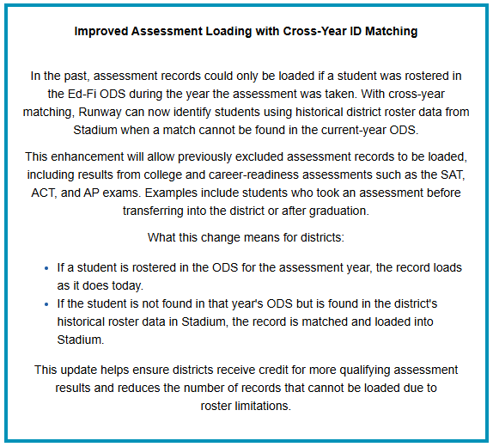
Assessment Loading Update
Per EA’s 6/12/2026 Newsletter →
EA will also be providing PD for the feature update during upcoming office hours. Keep an eye on your weekly EA newsletter for more details.
Not getting the newsletter?
Sign up here

Slide 8
Process Responsibility
  A district corrections designee was appointed by each superintendent.
  The designee is the district’s primary point of contact for corrections.
  The person indicated as designee should be actively working for the district for the duration of the corrections period.

Slide 9
Three Distinct Corrections Windows
Window | Purpose | District Submission | SCDE Review | Updated Release
Denominator | Verify student inclusion eligibility | July 13–17 | July 20–31 | Updated file provided in ADT: Week of August 3
Numerator | Verify student outcomes/results | Aug. 31–Sept. 4 | Sept. 8–21 | Updated file provided in ADT: Week of September 21
Preliminary Ratings | Review preliminary ratings posted to embargo site | Sept. 28–30 | Final validation | Updated to embargo site: October 1
  Bottom line: Each window is distinct and serves a specific role in ensuring accurate accountability reporting.
Notes:
Wendy

Slide 10
What makes data a part of the denominator?
The denominator in this context refers to the total number of students that are eligible to be counted in the metric's calculation. It is a critical component that ensures the accuracy and fairness of the metrics reported in the school report card.
The decision to include a student in the denominator is based on predefined criteria that are strictly adhered to, ensuring consistency across all metrics.
It is important to note that this review does not encompass the actual values earned by the students for the metrics. The focus here is solely on the inclusion criteria, which are instrumental in shaping the denominator.
Denominator does not review test scores, credit or diploma outcomes, points earned, or ratings.
Key Process: Student Record → Eligibility Rules Applied → Included / Not Included

Slide 11
What makes data a part of the numerator?
The numerator references the students’ outcomes related to each metric. These include outcomes such as test score, credits, and diplomas earned.
The values earned from student outcomes are based on predefined criteria that are strictly adhered to, ensuring consistency across all metrics.
It is important to note that this review builds off the denominator corrections. Students finalized to the denominator will be the data set to apply numerator outcomes. Corrections will only be applied to the student outcomes.
Key Process: Student Outcome → Values Applied → Exclusion Applied → Metric Calculation

Slide 12
Denominator vs. Numerator Review
Denominator Review | Numerator Review
Who should be included? | What outcome did the student earn?
Key Features
Continuous enrollment | Outcome verification
Course enrollment | Test scores
Cohort inclusion | Credits earned
ML eligibility | Diplomas earned
Participation inclusion | Exclusions applied
Key Clarification
Denominator = inclusion
Numerator = outcome

Slide 13
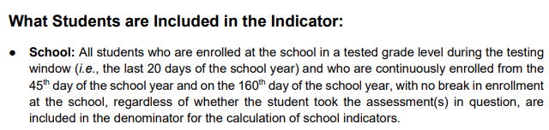
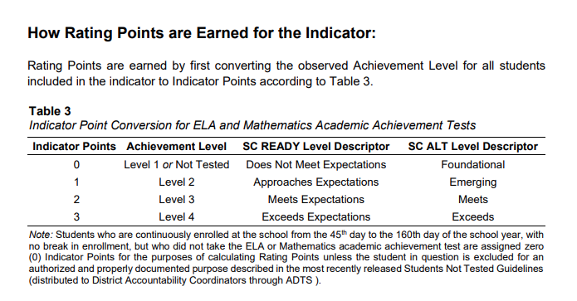
Denominator vs. Numerator Example
Denominator Review | Numerator Review
Who should be included? | What outcome did the student earn?
Academic Achievement: EMS
Key Clarification
Denominator = inclusion
Numerator = outcome

Slide 14
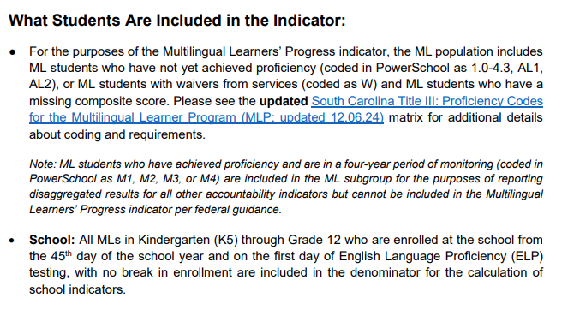
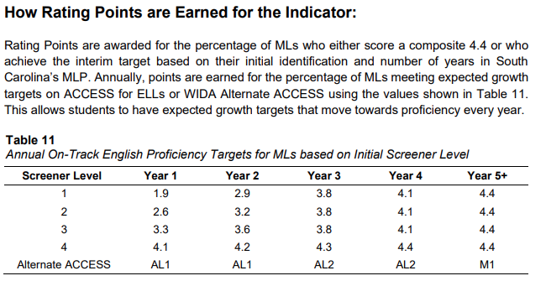
Denominator vs. Numerator Example: ML Progress
Denominator Review | Numerator Review
Who should be included? | What outcome did the student earn?
Multilingual Learners’ Progress
Key Clarification
Denominator = inclusion
Numerator = outcome

Slide 15
What do I expect for preliminary ratings review?
The denominator (eligibility) and numerator (values) have been set.
The rating outcomes are based on predefined criteria that are strictly adhered to, ensuring consistency across all metrics.
Ratings review allows districts to review preliminary metric outcomes posted to embargo site.
Corrections for this window emphasize possible errors in the calculations of the already determined values.
Key Process: Metric calculation review

Slide 16
Putting the three processes together
Denominator Review
Numerator Review
Metric Review
Key Process: Student Record → Eligibility Rules Applied → Included / Not Included
Key Process: Student Outcome → Values Applied → Exclusion Applied → Metric Calculation
Key Process: Metric calculation review

Slide 17
District Submissions
  An eSupport SolarWinds ticket alerts SCDE to corrections submission and provides a clear communication channel for SCDE review and district progress update.
  2 main deliverables for each window:
    An accurately completed and renamed corrections template
    A corrections plan reviewing steps to be taken to resolve the issue, when applicable.
  ADT is the collection source for deliverables due to PII.
  Districts are to ensure proper documentation for the requested correction exists, but this will not be submitted unless specifically requested.
  Professional development sessions, key resources, and the accountability manual may all be used to support a deeper understanding of inclusion in metric denominator (window 1), numerator (window 2), and ratings calculations (window 3).

Slide 18
SCDE Review
  An eSupport SolarWinds ticket begins the process on the SCDE side of the correction request.
  A corrections review team will review district submissions.
  The ticket will be resolved in SolarWinds with feedback to the district.
  Approved submissions will be processed for coding updates.
  Updated files will be produced as listed in the key dates table in a previous slide.

Slide 19
Corrections Window
Process
Notes:
Agenda is 88 pt
Line item is 66 pt

Slide 20
Corrections Submission Process
District receives files in ADT
District completes corrections template
District verifies supporting documentation
District reviews student records
District uploads corrections template and plan to ADT
SCDE reviews request
District completes corrections plan
District submits SolarWinds ticket
Updates
distributed

Slide 21
How do you get the data files?
Where?
Access student level data file in ADT – Accountability folder
  Denominator and numerator windows
Report Card Embargo portal
  Ratings review
When?
  Denominator file will post by July 13th
  Numerator file will post by August 31st
  Ratings will post by September 28th
An email from schoolreportcards@ed.sc.gov will alert the designee to file availability and review next steps

Slide 22
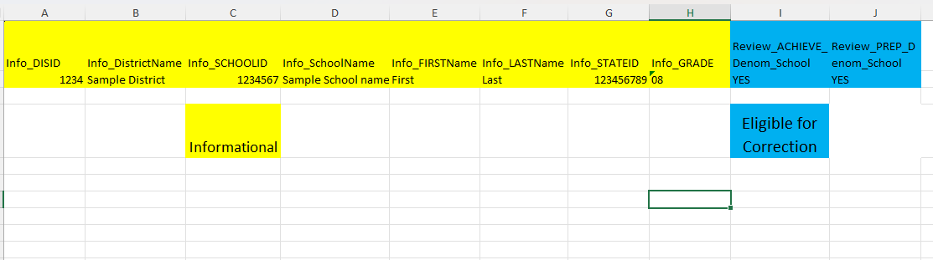
What to do once you get the file?
Review it and remember what you are looking for in that window.
First 8 columns provide student level identifier information.
It is important to note that the corrections window is to correct school report card outcomes exclusively.

Slide 23
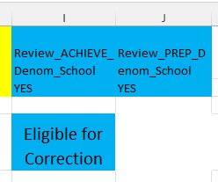
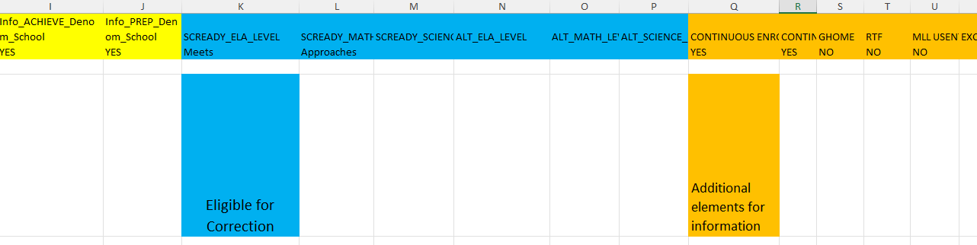
Academic Achievement & Preparing for Success: EMS
Denominator
Numerator

Slide 24
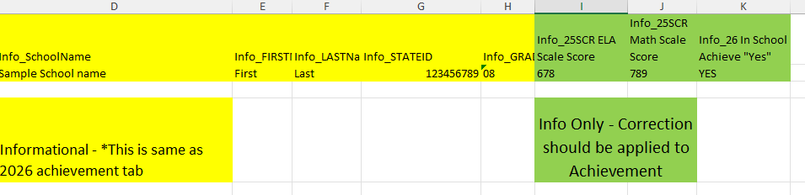
Student Progress
Denominator
Numerator
Final student progress file will be generated by EA based on student outcomes.
Overall student progress outcomes use VAM and AVGM. Due to the comparative nature of VAM metrics based on SC Ready results, student progress is not eligible for corrections.
However, ensuring corrections are applied to Academic Achievement and that SC Ready scores are accurate in Admin Navigator supports accurate Student Progress outcomes.

Slide 25
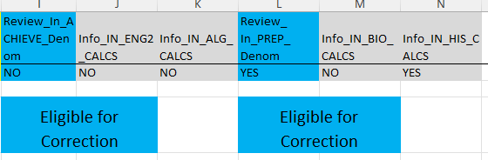
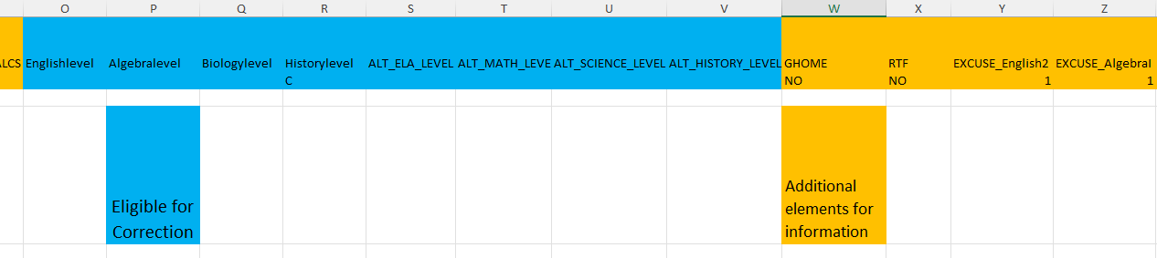
Academic Achievement & Preparing for Success: HS
Denominator
Numerator

Slide 26
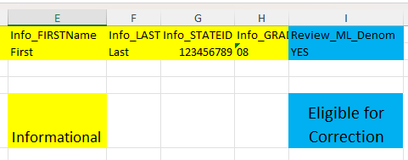
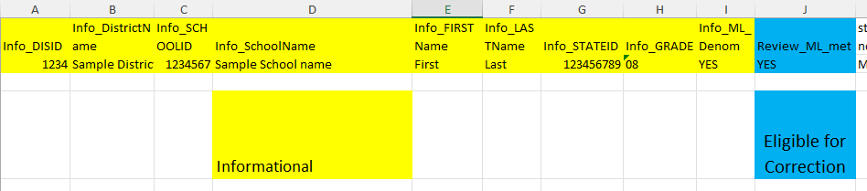
ML Progress
Denominator
Numerator

Slide 27
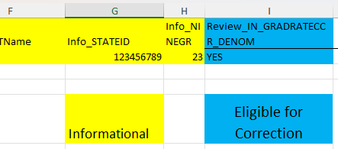
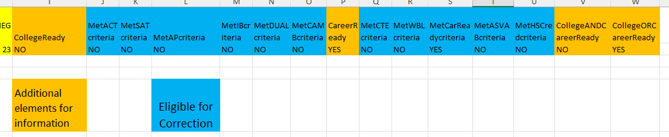
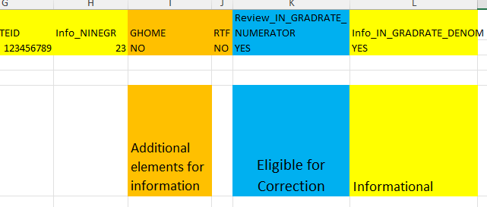
Grad Rate & CCR
Denominator
Numerator: CCR
Numerator: Grad Rate
Because both metrics are based on inclusion in the 9GR23 cohort, there is only one denominator tab.

Slide 28
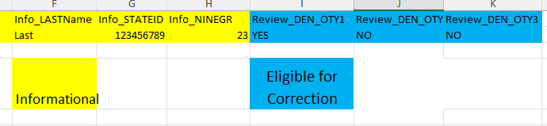
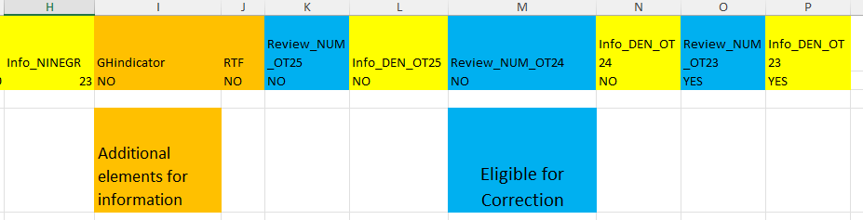
High School Student Success: On-Track to Graduate
Denominator
Numerator

Slide 29
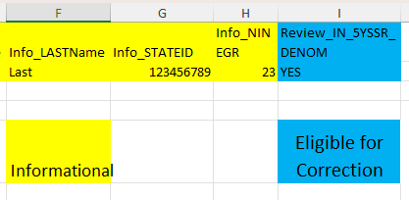
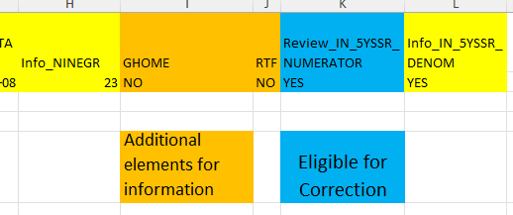
High School Student Success: 5th Yea
Denominator
Numerator

Slide 30
What to do when you identify an error?
Research the concern
Use accountability manual for specific inclusion parameters
Use PDs to review inclusion parameters and coding requirements
Determine issue
Determine if there is evidence to support a correction
Fill in corrections template
Complete submission process

Slide 31
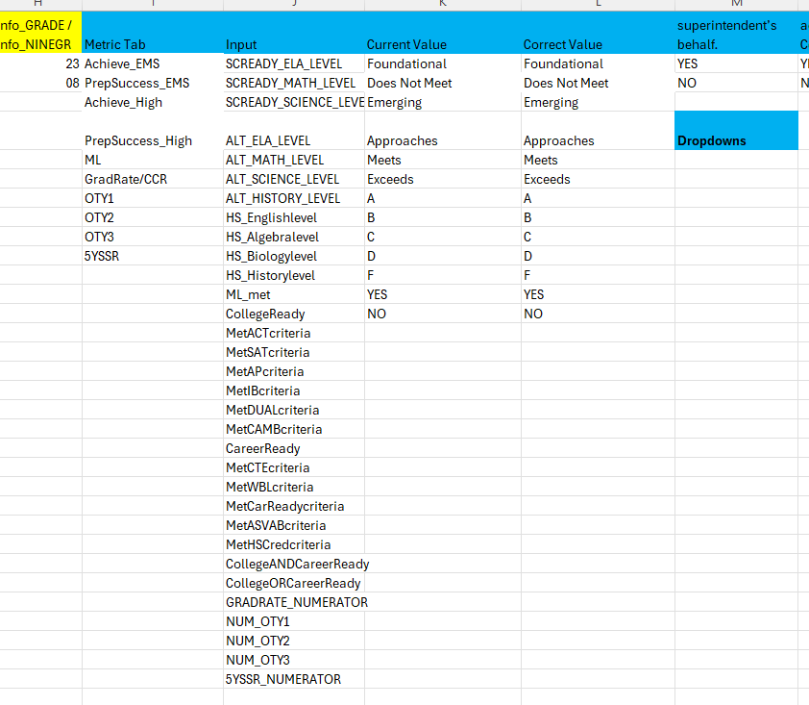
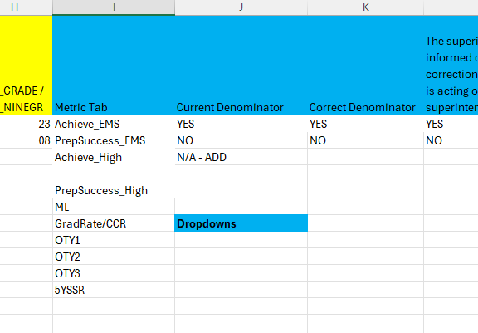
Use the template for the related window
Denominator
Numerator
Templates will be emailed to the corrections designee

Slide 32
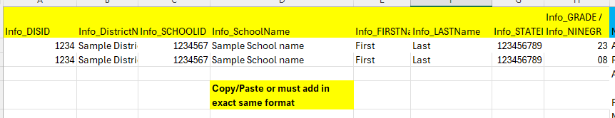
Consistent Format
First 8 columns are the same in each tab of the student level data files
First 8 columns in corrections template are intended to match the student level data file
  Use copy/paste from the student level data file for the first 8 columns to edit a student’s denominator or numerator value
  Use the same format of the first 8 columns to add a student’s data
It is critical that you correctly fill in all columns. No columns are optional. Corrections with incomplete or missing data will not be processed.

Slide 33
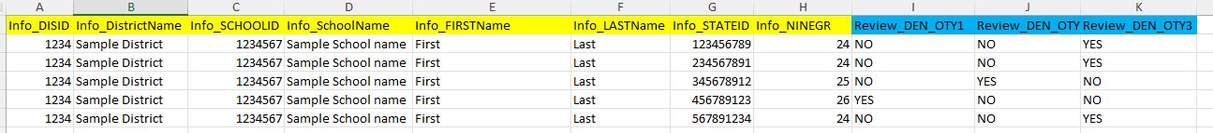
Example for removing the issue(s) in the template
Example use case – Cohort removal
Identify student level data to correct →
Copy/paste the first 8 columns of the student level data identifiers into the corrections template →
Changing the denominator from yes to no removes the student.
Select the metric, current value, and corrected value →

Slide 34
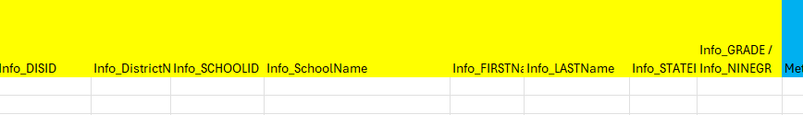

Example for adding student(s) in the template
Example use case – Adding missing 9GR23 early graduate
Indicating denominator “Yes” adds the student to the metric. These students will then be on your numerator file to add any related outcomes.
Important to note: Student must be in the denominator to have an outcome value coded in the numerator.
Go to the next blank row on your corrections template →
Enter the student’s details into the first 8 columns; be sure to match the format of the student level data identifiers →
Select the metric, current value as “N/A-add”, and correct value →

Slide 35
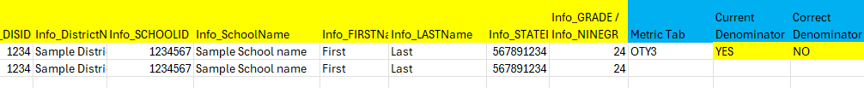
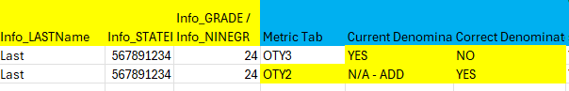
Example for editing the denominator metric assignment
Example use case – Incorrect 9GR, need to move cohort assignment
Identify student level data to correct →
Copy/paste the first 8 columns of the student level data identifiers into the corrections template →
This is combination of remove and add.
Use when removing from one metric and adding to another.
Select the metric, current value, and corrected value that REMOVES student →
Copy/paste the first 8 columns of the student level data identifiers AGAIN into the corrections template →
Select the metric, current value, and corrected value that ADDS student →

Slide 36
Example for editing the school assignment
Example use case – Student rostered to incorrect school
Identify student level data to correct →
Copy/paste the first 8 columns of the student level data identifiers into the corrections template →
This is combination of remove and add. Ensure correct school ID is noted for the student.
Important to note that additions will only be made to schools within the district requesting the correction.
Select the metric, current value, and corrected value that REMOVES student →
Enter the student’s CORRECT details into the first 8 columns; be sure to match the format of the student level data identifiers and corrected value that ADDS student →

Slide 37


Example for editing the outcome in the template
Example use case – Adding a 9GR23 Summer graduate’s diploma
Identify student level data to correct →
Edits allow you to update the student’s outcome reflected in the numerator file.
Copy/paste the first 8 columns of the student level data identifiers into the corrections template →
Select the metric, current value, and corrected value →

Slide 38
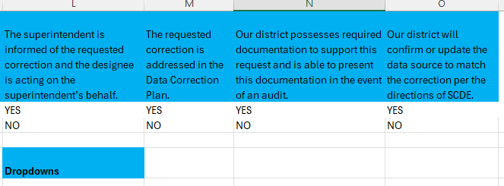
Complete Verifications
Important to note that corrections without “Yes” verifications will not be processed.
Have a planned system for collection of supporting documentation for each requested correction. Be prepared for an audit.

Slide 39
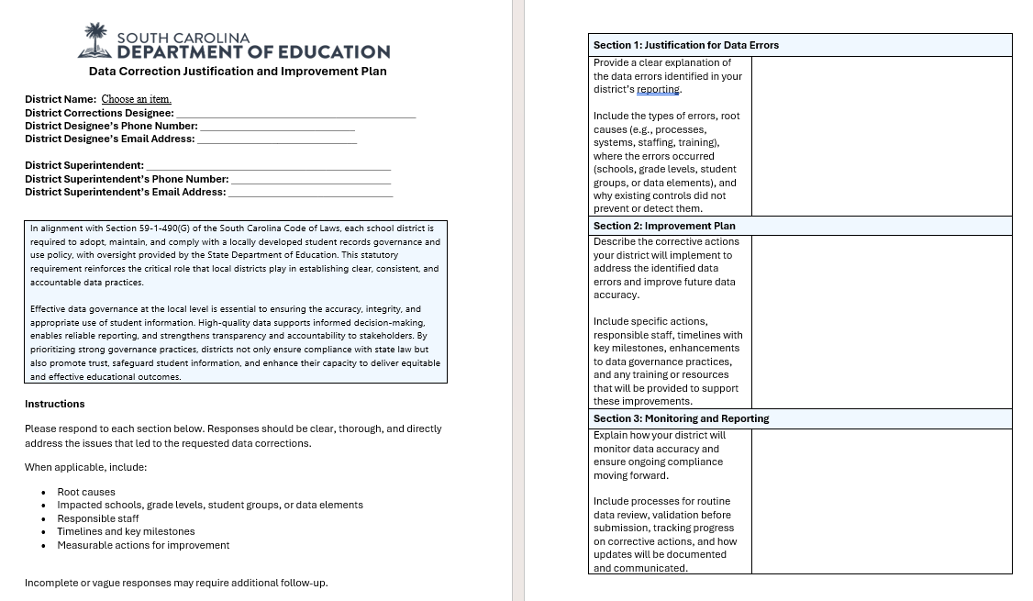
Write corrections plan related to submission
To be completed for each window that a corrections request is submitted.
The document provides justification for the corrections requested and insight for the corrections approval team.
Ensure each type of or pattern of correction requests is reviewed.

Slide 40
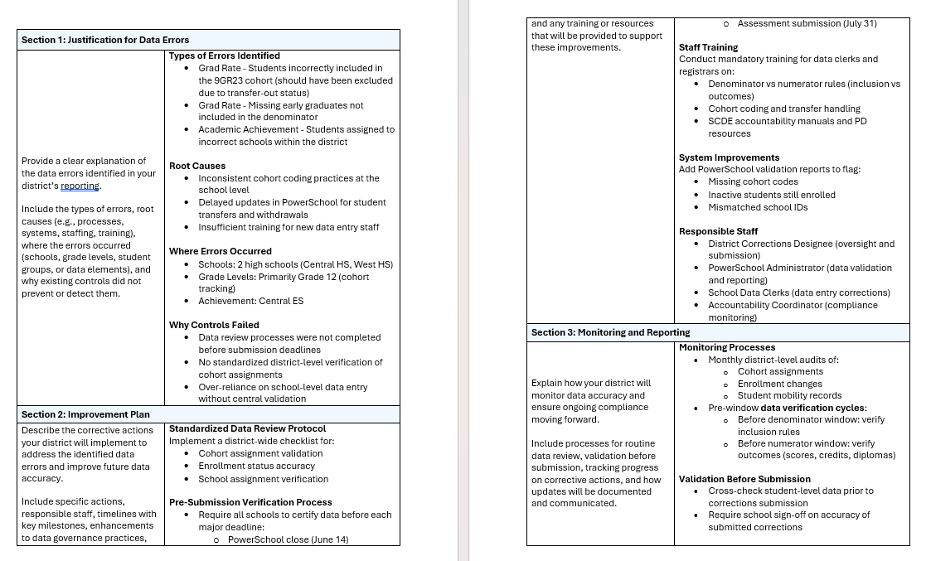
Corrections plan example
This document provides justification for the corrections and insight for the corrections approval team.
Ensure each type of or pattern of correction requests is reviewed.

Slide 41
Rename both files as directed
For each window you will submit to the district’s ADT Accountability folder:
1.) An Excel file with the list of corrections
2.) A correction plan
Rename the templates as follows:
Add the 4-digit district code put to the start of the existing file name followed by an underscore, then the district name, and then another underscore.
Format:
XXXX_District Name_
Example:
1212_SC District Name_

Slide 42
Submit filled template and plan to ADT
Steps:
Log into the ADT portal.
Select the Accountability Coordinator district-level folder.
Add your filled template to this folder, ensuring that you added the appropriate information to the beginning of the file name (i.e., ensuring that the file is renamed appropriately as clarified in a previous slide).

Slide 43
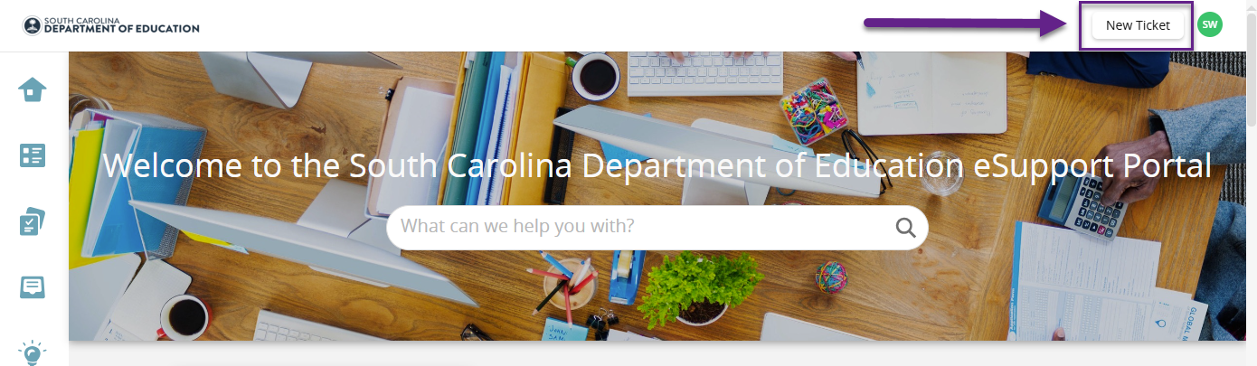
Submit ticket for SCDE review – Log in
1 – Go to the eSupport Solar Winds portal and log in: https://esupport.ed.sc.gov/
2 – Click "New Ticket"

Slide 44
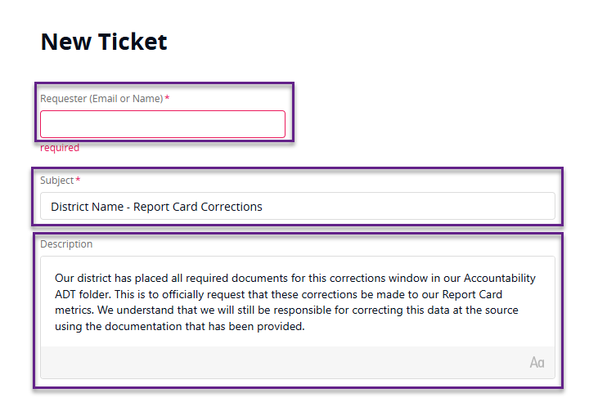
Submit ticket for SCDE review – New Ticket
3 – Include the information shown below.
IMPORTANT:
For the first two corrections windows (Denominator and Numerator), as indicated in the screenshot to the left, data will need to be corrected in the source system -- either via PowerSchool (data such as for denominator inclusion) or via Runway (assessment data).
In the case of PowerSchool corrections, once the district has connected to Ed-Fi for the 26-27 school year, students with corrected data will need to be manually flagged as submitting to Ed-Fi, and their data will need to be sent to the 26-27 school year Ed-Fi API/ODS; instructions will be provided to assist with this step.

Slide 45
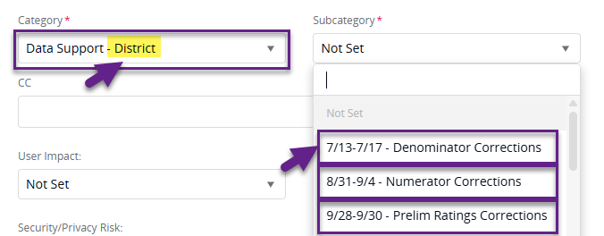
Submit ticket for SCDE review – Category
4 – In the "Category" dropdown, select Data Support – District.
5 – In the "Subcategory" dropdown, select the appropriate window.

Slide 46
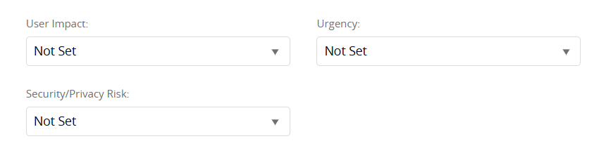
Submit ticket for SCDE review – Other Fields
6 – The fields shown below are not required and may be left blank.

Slide 47
Window 3 – Ratings Review
Window | Purpose | District Submission | SCDE Review | Updated Release
Preliminary Ratings | Review preliminary ratings posted to embargo site | Sept. 28–30 | Final validation | Updated to embargo site: October 1
  Communication
  Embargo portal access details will be emailed from schoolreportcards@ed.sc.gov
  Additional updates and what to expect will be shared via email as report card elements become available
  Ratings Review Window (Sept 28–30)
  Submit correction requests through SolarWinds
  Include clear calculation rationale
  If needed, SCDE may request student-level details from the designated contact
Notes:
Wendy

Slide 48
Corrections Window
Follow Up
Notes:
Agenda is 88 pt
Line item is 66 pt

Slide 49
You get a response from your ticket
Keep track of your ticket number.
Log back into the ticketing portal to view responses on your ticket.
Reply, if needed, within the portal.

Slide 50
Updates at end of each cycle window, see key dates
Window | Purpose | District Submission | SCDE Review | Updated Release
Denominator | Verify student inclusion eligibility | July 13–17 | July 20–31 | Updated file provided in ADT: Week of August 3
Numerator | Verify student outcomes/results | Aug. 31–Sept. 4 | Sept. 8–21 | Updated file provided in ADT: Week of September 21
Preliminary Ratings | Review preliminary ratings posted to embargo site | Sept. 28–30 | Final validation | Updated to embargo site: October 1

Slide 51
Housekeeping
Notes:
Agenda is 88 pt
Line item is 66 pt

Slide 52
Updates and Additional Information
Assessment Data
WIN
Data has been loaded to Ed-Fi. Resolve errors as needed.
ACT
Updated ACT score files were released to districts by ACT on May 22, and any changes reflect score increases or confirmed values.
Option 1- Upload new file to Runway and resolve errors as needed.
  Option 2 - Upload only updated scores and resolve errors as needed.

Slide 53
Planning Time
Notes:
Agenda is 88 pt
Line item is 66 pt

Slide 54
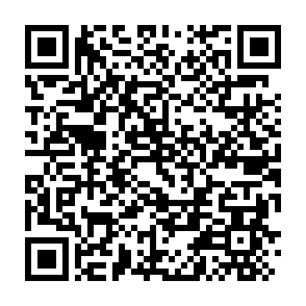
Session Evaluation
Please complete an evaluation of the session using the QR Code.
Notes:
Header font 50pt
Content/body text font 28pt

Slide 55
Planning Time: Key Concepts
We have covered a lot of information today:
  Progress toward supporting accurate 25-26 data
  Timeline for corrections windows
  Processes to submit corrections
  What to expect after submission
This means you have a lot of information to plan for, act on and communicate.
Notes:
Header font 50pt
Content/body text font 28pt

Slide 56
Planning Time: Key Questions
Questions | Priority 1 | Priority 2 | Priority 3
What needs to be communicated?
Who is the audience?
How does it need to be communicated?
When does it need to be communicated?
How do you plan to follow up to ensure implementation is occurring?
Notes:
Header font 50pt
Content/body text font 28pt

Slide 57
Key Documents
Accountability Manuals
SIS Data Entry Manual
Level Data validations
Cohort Maintenance Information and Resources web page
  Cohort Progression Maintenance Manual
  SCDE Memo (July 25, 2023) - Student Enrollment, Age-Appropriate Placement, Ninth Grade Cohort, and International Transcript Guidance
SC PowerSchool to Ed-Fi Mapping
SC Assessment Required Fields for College & Career Readiness
Accountability-oriented Mapping Documents
  Academic Achievement
  College and Career Readiness
  Graduation Rate
  High School Student Success
  Multilingual Learner Progress
  Preparing for Success
  Student Progress
  School Climate
Prior session videos & slides
  Topic 1: Cohorts (Video & PPT)
  Topic 2: Graduation Rate and High School Student Success Indicator (Video & PPT)
    Updated PPT with additional dual enrollment for HSSSI guidance
  Topic 3: College and Career Readiness (Video & PPT)
  Topic 4: Participation Rate & SNT (Resources posted to ADT)
  Topic 5: Corrections Window - Overview (Video & PPT)
Main site for all resources: https://ed.sc.gov/data/schoolreportcard/
Notes:
Header font 50pt
Content/body text font 28pt

Slide 58
Key Takeaways
SCDE is working to improve the 2026 report card process.
Key steps already taken and underway.
  Development of a cross-functional team
  Prioritization of improvement projects
  Professional development sessions and resource website
  Manuals for data flows and accountability implications
  Specific work groups established to address critical issues
  Routine data alignment and outcome checks
  Support surfacing near real-time data views and verification to align with district needs
  A consistent, informed opportunity for data verification and correction
We need districts working to ensure a successful delivery of the 2026 report cards.

Slide 59

Vann Holden
Era Roberts
Wendy Stephens
cvholden@ed.sc.gov
Chief Research Officer
earoberts@ed.sc.gov
Accountability Program Manager
wstephens@ed.sc.gov
District and Technology Services Program Manager
Notes:
Insert your picture within the yellow circle (replace the SCDE logo inside circle)
Speaker/person photo should be in a circle frame
Should have a yellow outline
Should be 6 x 6 inches
Firstname/Lastname is font 80pt
Title, Copmany is 36pt (italic)

Slide 60
Session Evaluation: QR Code
Please complete an evaluation of the session using the QR Code.
Notes:
Header font 50pt
Content/body text font 28pt

Slide 61
ed.sc.gov
Notes:
Slide title is hidden from display

