Slide 1

Cohorts
Accountability Coordinators, District Testing Coordinators, Assessment Proxies, and PowerSchool Administrators
Vann Holden, PhD and Wendy Stephens
January 2026
Notes:
Slide title should be Aptos Bold font, left-aligned, not smaller than 44pt
Audience – To whom/group you are presenting to
Speaker – Who is giving the presentation (may be by name or by department)
Date – Date of presentation

Slide 2
Agenda
What is a cohort?
What are the coding requirements?
How can we verify our data on cohorts?
What should we do if cohort data looks inaccurate?
Planning Time
Next Steps
Notes:
Left aligned
Title font is 88pt
Numbered line item 66 pt
Detail/slide item 36 pt

Slide 3
Cohorts
Notes:
Agenda is 88 pt
Line item is 66 pt

Slide 4

Cohort
In the accountability context, a cohort is generally a group of students who entered a high school in the United States for the first time on or prior to the 45th day of a given school year.
The 9GR is the student’s 9th grade code. This tells us which high school cohort the student is in for accountability purposes.
Notes:
Header font 50pt
Content/body text font 28pt

Slide 5
Cohort
A student who enrolls for the first time in a United States high school is added to the four-year graduation cohort (9GR). If a high school aged student without a transcript enrolls for their first year in a U.S. high school on or prior to the 45th day, the 9GR will be set to the two-digit year of the spring semester of that school year (e.g., for students who the 2025-26 school year is their first year in a U.S. high school will have a 9GR=26).
If an international student enrolls with enough credits to be classified as a junior, their 9GR will be the same as a first-year freshman as it is their first year of high school in the U.S. Students who enroll at an older age must be allowed to accrue credits to meet graduation requirements until they age out of school.
https://ed.sc.gov/data/cohort-maintenance-information-and-resources/cohort-progression-maintenance-manual/
https://ed.sc.gov/newsroom/school-district-memoranda-archive/student-enrollment-age-appropriate-placement-ninth-grade-cohort-and-international-transcript-guidance/student-enrollment-age-appropriate-placement-ninth-grade-cohort-and-international-transcript-guidance-memo/
Notes:
Header font 50pt
Content/body text font 28pt

Slide 6
Cohort
What if a student transfers in from a South Carolina public school after the 45th day?
  If the student was in 9th grade prior to the transfer, assign the 9GR that was provided by the sending school.
  If the student was in 8th grade prior to the transfer or had no 9GR, use the subsequent year's 9GR value.

Slide 7
Cohort
What if a student transfers from a Private School, Homeschool, or Non-South Carolina school after the 45th day?
  Determine the student's original entry into 9th grade after reviewing the transcript and assign the corresponding 9GR value.
Notes:
Header font 50pt
Content/body text font 28pt

Slide 8
Cohort
What if a student transfers in from a school outside the United States after the 45th day?
  If a high school aged student without a transcript enrolls for their first year in a U.S. high school after the 45th day, the 9GR will be set to the two-digit year of the spring semester for the following school year (i.e., the school year in which they are enrolled for their first 45th day; e.g., a student who enrolls for the first time in a U.S. high school in January of 2026 will have 9GR=27).
  If an international student enrolls with enough credits to be classified as a junior, their 9GR will be the same as a first-year freshman as it is their first year of high school in the U.S. Students who enroll at an older age must be allowed to accrue credits to meet graduation requirements until they age out of school.
https://ed.sc.gov/data/cohort-maintenance-information-and-resources/cohort-progression-maintenance-manual/
https://ed.sc.gov/newsroom/school-district-memoranda-archive/student-enrollment-age-appropriate-placement-ninth-grade-cohort-and-international-transcript-guidance/student-enrollment-age-appropriate-placement-ninth-grade-cohort-and-international-transcript-guidance-memo/
Notes:
Header font 50pt
Content/body text font 28pt

Slide 9
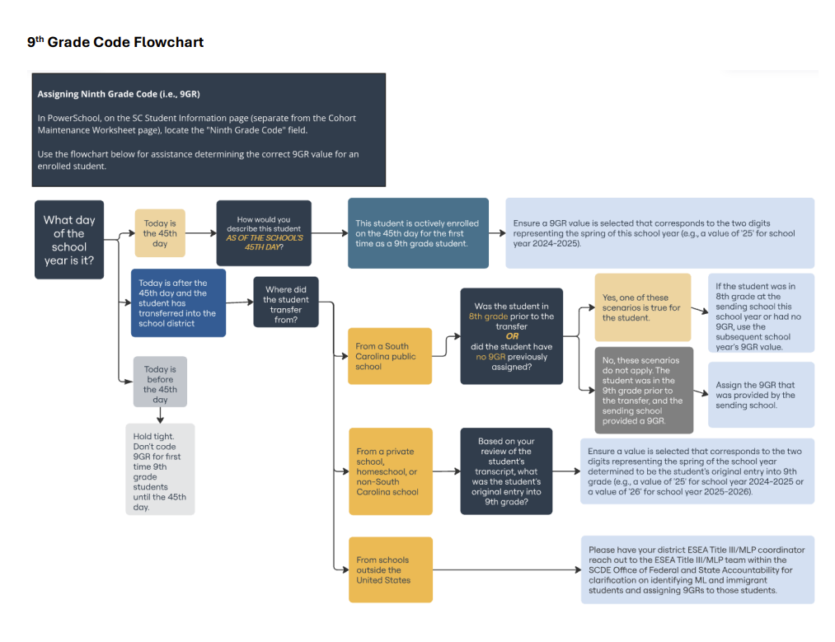
9th Grade Code Flowchart
https://ed.sc.gov/data/cohort-maintenance-information-and-resources/ninth-grade-code-flowchart/
Notes:
Header font 50pt
Content/body text font 28pt

Slide 10
Cohort
A student can be removed from the four-year graduation cohort.
The United States Department of Education (USED) issued guidance on the maintenance of the four-year graduation cohort, including documentation requirements for exclusions from a cohort, in January 2017.
SCDE uses that guidance as the foundation for maintaining cohorts related to Graduation Rate, College and Career Readiness, On-Track to Graduation, and Five-Year Student Success metrics.
https://www2.ed.gov/policy/elsec/leg/essa/essagradrateguidance.pdf
Notes:
Header font 50pt
Content/body text font 28pt

Slide 11
Cohort
Reasons a student might be excluded from the four-year graduation cohort:
  Student death
  Student Émigré (including Foreign Exchange Students who have left the country)
  Student has been found guilty of a crime and transferred to diploma program at a correctional institution - Department of Juvenile Justice (DJJ) or Department of Corrections (DOC).
    The student must be serving their sentence at the facility, not awaiting adjudication.
  Student is awaiting trial and a public school or district is providing educational services to that student awaiting trial. The student is enrolled at the high school only for record keeping purposes (enrolled in a program with LAD and LJD codes in PS only).
  Student entering home schooling
  Student transferred to a public school within South Carolina before the end of the school year.
  Student transferred to a public high school diploma-granting institution outside the SC public school system before end of school year OR Student enrolled in the high school diploma program of a non-public (private) institution before end of school year.
Notes:
Header font 50pt
Content/body text font 28pt

Slide 12
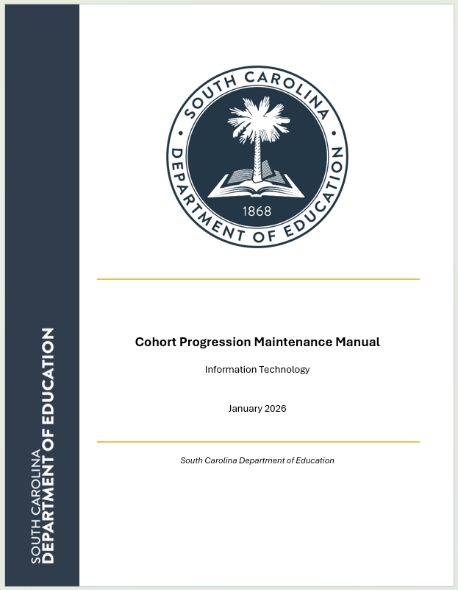
Cohort
Schools must maintain documentation of students’ removal reason.
Please see the Cohort Progression Maintenance Manual for documentation requirements.
https://ed.sc.gov/data/cohort-maintenance-information-and-resources/cohort-progression-maintenance-manual/
Notes:
Header font 50pt
Content/body text font 28pt

Slide 13

Cohorts
High school accountability ratings are heavily dependent on cohort data.
Graduation rate – denominator
College and career readiness – denominator
High school student success – denominator
Academic achievement – students who have not already been included in the academic achievement metric are included in their fourth year of high school
Preparing for success – students who have not already been included in the academic achievement metric are included in their fourth year of high school
Notes:
Header font 50pt
Content/body text font 28pt

Slide 14
Coding Requirements
Notes:
Agenda is 88 pt
Line item is 66 pt

Slide 15

Coding requirements
Why are PowerSchool data entry and Ed-Fi publishing important for Cohorts?
As of school year 2025-2026, only PowerSchool data entry determines whether a high school student is included in or excluded from a particular accountability cohort.
The values for the required fields ("9GR" and "In Denominator"), as they exist in Ed-Fi on the final day of each year’s data collection, will determine students’ cohort status for accountability calculations.
Notes:
Header font 50pt
Content/body text font 28pt

Slide 16

Coding requirements
Required PowerSchool fields:
9GR
  PowerSchool page:
  South Carolina Student Information
  Field label: Ninth Grade Code
  Table.field: s_sc_stu_x.ninthgradecode
In Denominator
  PowerSchool page:
  Cohort Maintenance Worksheet
  Field label:
  Student Should Remain in Cohort (denominator)?
  Table.field:
  S_SC_STU_GRAD_WRKSHEET_X.
  Student_In_Denominator
Notes:
Header font 50pt
Content/body text font 28pt

Slide 17
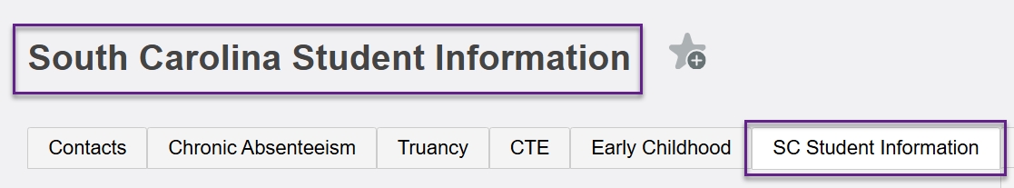
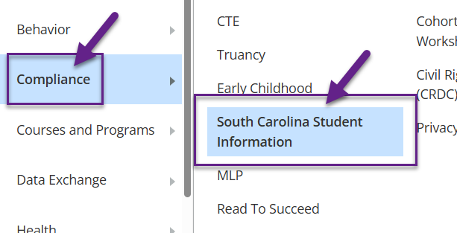
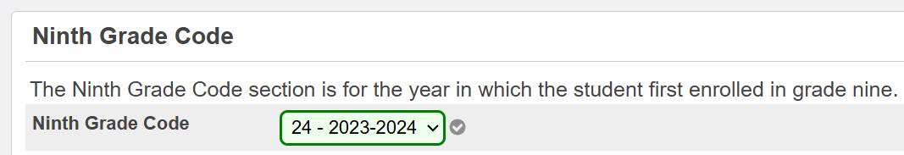
Coding requirements
Where in PowerSchool to code 9GR
A student’s cohort is determined by the value in PowerSchool for the field labeled Ninth Grade Code on the South Carolina Student Information page.
Notes:
Header font 50pt
Content/body text font 28pt

Slide 18
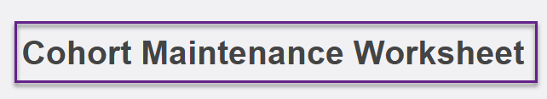

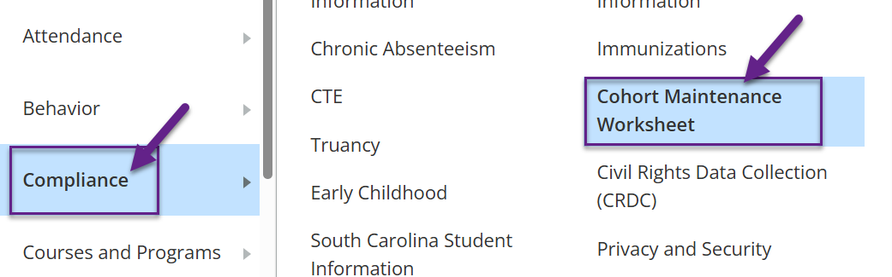

Coding requirements
Where in PowerSchool to code In Denominator
Students are coded for cohort inclusion through using the field labeled Student Should Remain in Cohort? (also known as the Denominator) on the Cohort Maintenance Worksheet page in PowerSchool.
Notes:
Header font 50pt
Content/body text font 28pt

Slide 19
Coding requirements
Dropdown values for the In Denominator field
  Selecting the YES value for this field indicates a student meets the criteria to be included in a cohort.
  Selecting the NO value for this field indicates a student meets the criteria to be excluded from all cohorts;
  If a value is not selected, a (blank) value will be published for the student.
Values of YES or (blank) in this field indicate cohort inclusion.
Notes:
Header font 50pt
Content/body text font 28pt

Slide 20

Coding requirements
When to code "9GR" data
When a student is enrolled in ninth grade for the first time, the 9GR must be assigned by the 45th day of that school year.
Please see either previous slides in this presentation or the Cohort Progression Maintenance Manual for cases in which the student enrolls after the 45th day.
Notes:
Header font 50pt
Content/body text font 28pt

Slide 21
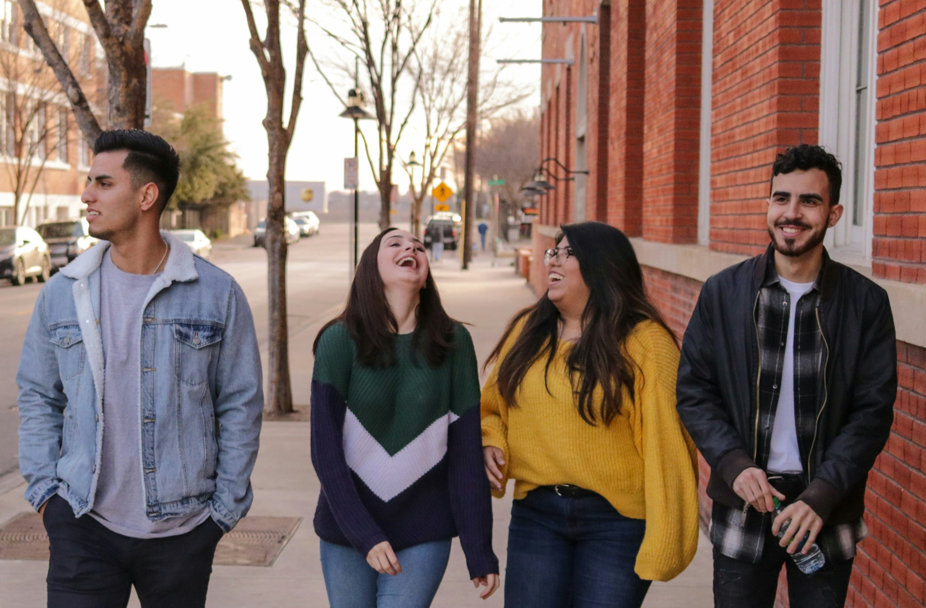
Coding requirements
When to code "In Denominator" data
Rather than waiting until the end of the school year, utilize the Cohort Maintenance Worksheet page in PowerSchool throughout the year to identify students who should be excluded from a cohort.
For students coded for removal from a cohort, keep the documentation verifying the reason for the removal for at least four years following the assigned cohort’s graduation date.
Review of documentation may be necessary should there be a Title 1 audit.
Digitized documents are acceptable and their availability may be maintained in PowerSchool.
Notes:
Header font 50pt
Content/body text font 28pt

Slide 22
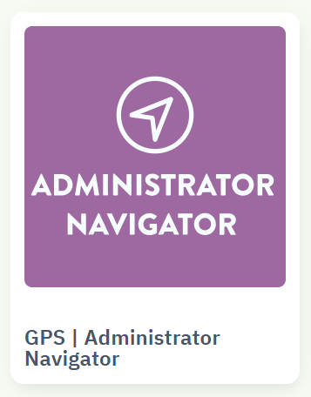
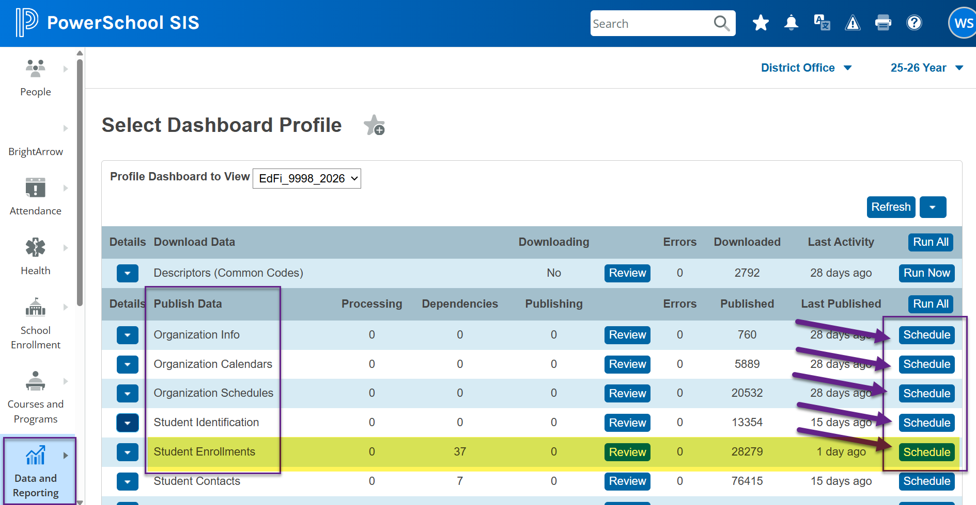
How does data make it to SCDE?
Once data is entered in PowerSchool and published to Ed-Fi by 7:00 p.m., you can verify data in Administrator Navigator the next day!
Notes:
Header font 50pt
Content/body text font 28pt

Slide 23
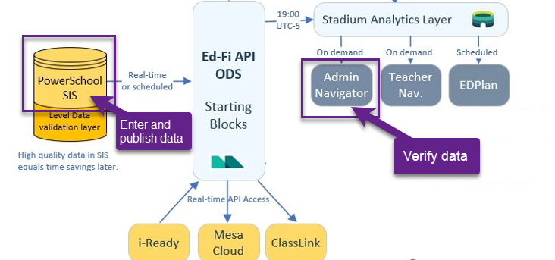
How does data make it to SCDE?
Notes:
Header font 50pt
Content/body text font 28pt

Slide 24
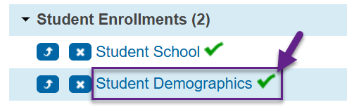
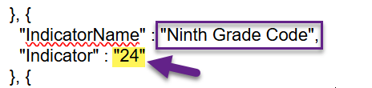
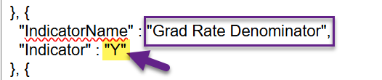
How does the data make it to SCDE?
It never hurts to spot check for successful publishing!
1 - Select a student whose "9GR" and "In Denominator" data values you wish to check.
2 - Go to the student's "publishing" page in PowerSchool (Data Exchange > Publishing).
3 - Click the green check mark next to "Student Demographics."
4 - Look for
  the Indicator value associated with theIndicatorName "Ninth Grade Code"
  the Indicator value associated with the IndicatorName "Grad Rate Denominator"
Notes:
Header font 50pt
Content/body text font 28pt

Slide 25
Verifying Your Data
Notes:
Agenda is 88 pt
Line item is 66 pt

Slide 26
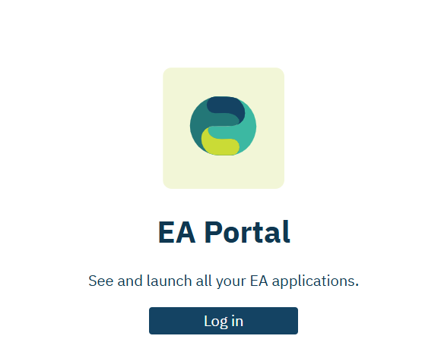
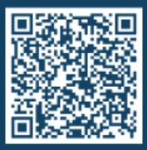
Verifying Data
Please go to Admin Navigator.
  https://portal.edanalytics.app/
If you do not have access to Admin Navigator, please scan the QR code below to find out who in your district can provide you with access.
Notes:
Header font 50pt
Content/body text font 28pt

Slide 27
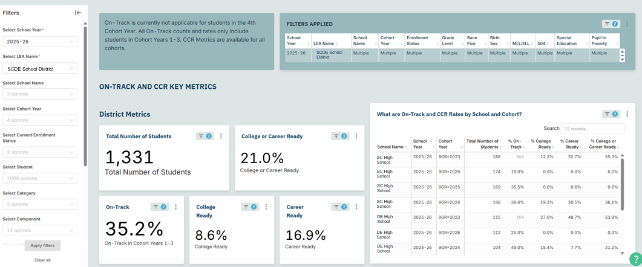
Verifying Data
In Admin Navigator, go to the On-Track and College & Career Readiness Dashboard.
Notes:
Header font 50pt
Content/body text font 28pt

Slide 28
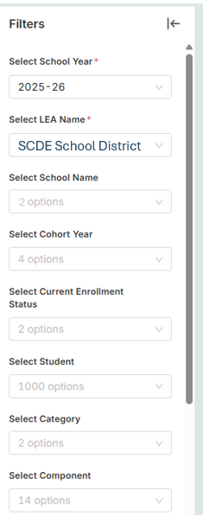
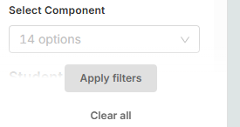
Verifying Data
In Admin Navigator, go to the On-Track and College & Career Readiness Dashboard.
  Select School Year – 2025-26
  Select LEA Name – Your district
  Select School Name – If needed
  Select Cohort Year – If needed
  Apply filters
Notes:
Header font 50pt
Content/body text font 28pt

Slide 29
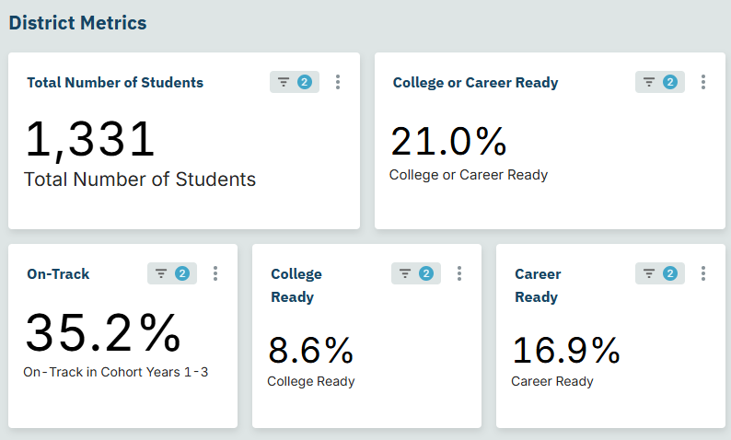
Verifying Data
Notes:
Header font 50pt
Content/body text font 28pt

Slide 30
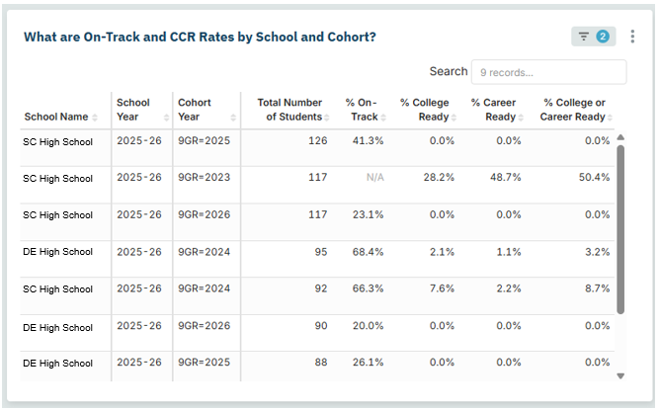
Verifying Data
Notes:
Header font 50pt
Content/body text font 28pt

Slide 31
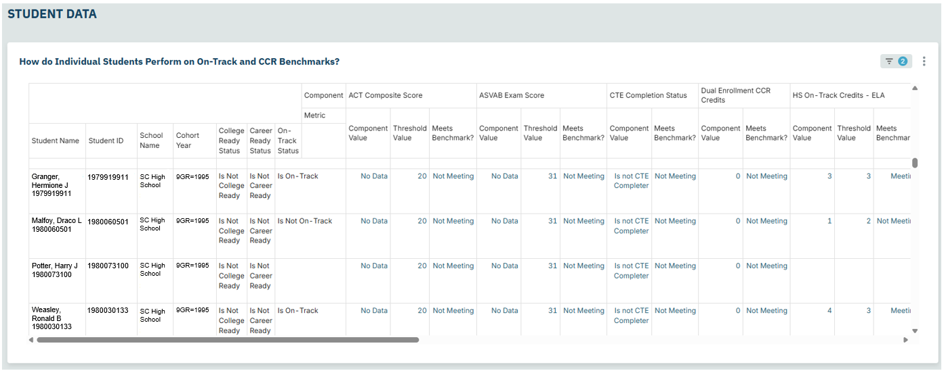
Verifying Data
Notes:
Header font 50pt
Content/body text font 28pt

Slide 32
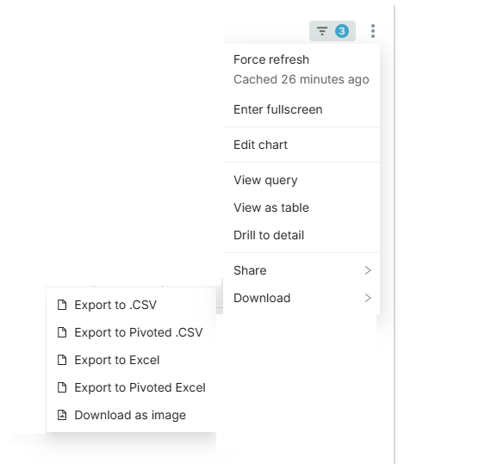
Verifying Data
Interested in exporting the data in that table?
  Click the three dots.
  Select “Download.”
  There are a variety of options.
  You should choose the one that works best for you and your data systems.
Notes:
Header font 50pt
Content/body text font 28pt

Slide 33
Verifying Data
Download Option | Headers | Rows per Student
Export to .CSV | Component, Student Name, Student ID, School Name, Cohort Year, College Ready Status, Career Ready Status, On-Track Status, Component Value, Threshold Value, Meets Benchmark? | Multiple per student
Export to Pivoted .CSV | 43 columns – Score/Value, Threshold Value, Meets Benchmark | One row per student
Export to Excel | Component, Student Name, Student ID, School Name, Cohort Year, College Ready Status, Career Ready Status, On-Track Status, Component Value, Threshold Value, Meets Benchmark? | Multiple per student
Export to Pivoted Excel – Most closely resembles the Admin Navigator Dashboard | 46 columns – Score/Value, Threshold Value, Meets Benchmark | One row per student
Notes:
Header font 50pt
Content/body text font 28pt

Slide 34
Verifying Data
Previously, SCDE provided cohort and basefiles via ADT to communicate which students districts should expect to be included in the four-year graduation cohorts.
For 2025-26, SCDE is using Admin Navigator to communicate this information.
Notes:
Header font 50pt
Content/body text font 28pt

Slide 35
Verifying Data
In past years, you could see the students who were included in the cohort as well as the students who were no longer included in your cohort.
In the current version of our dashboard, you can only see the students who are included in your cohort.
We are aware of requests to bring back the prior functionality, but that is not available at this time.
Notes:
Header font 50pt
Content/body text font 28pt

Slide 36
Verifying Data
This report updates nightly as your data updates, but note that depending on when publishing completes. There could be a 1- to 2-day lag between the coding of the data and it showing up in the report. To minimize the possibility of lag, aim to schedule publishing such that it is completed by 7:00 p.m.
These are the students SCDE anticipates will be in your cohort.
SCDE is running parallel tests to ensure EA and SCDE business rules are aligned.
Cohort data remains dynamic until you begin PowerSchool rollover or June 15 (whichever happens first). This becomes the denominator for all cohort related metrics.
Notes:
Header font 50pt
Content/body text font 28pt

Slide 37
Verifying Data
This report contains other information that will be used in future trainings (College Ready Status, Career Ready Status, On-Track Status).
Notes:
Header font 50pt
Content/body text font 28pt

Slide 38
Resolving Potential Issues
Notes:
Agenda is 88 pt
Line item is 66 pt

Slide 39

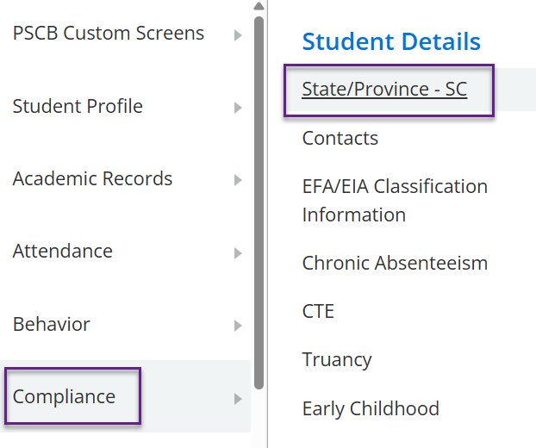
Resolving Potential Issues
Issue 1:
Student appears to be missing from a cohort.
Issue 2:
Student appears to be in the incorrect cohort.
For either of the issues above, work with a district PowerSchool administrator to
check to make sure the data have been correctly coded for both 9GR and In Denominator for the students in question.
check to make sure the correct data for the students has published to Ed-Fi (see the slide on spot checking).
If the students don't seem to be publishing, ensure that they are included in Ed-Fi publishing.
Notes:
Header font 50pt
Content/body text font 28pt

Slide 40
Resolving Potential Issues
Who to contact when all that fails?
Publishing issues: PowerSchool Support case
https://help.powerschool.com/t5/Case-Portal/ct-p/Support-CasePortal
Questions about Administrator Navigator: submit a ticket to Education Analytics
https://edanalytics.atlassian.net/helpcenter/products-and-services/user/login
SCDE Data Management Team
PowerSchool@ed.sc.gov
Notes:
Header font 50pt
Content/body text font 28pt

Slide 41
Resolving Potential Issues
Other ways to check within PowerSchool
Level Data validations
PowerSchool Start Page queries and quick look-ups
Export files (with any fields you'd like to include for any group you'd like to review!) directly from PowerSchool Data Export Manager
Notes:
Header font 50pt
Content/body text font 28pt

Slide 42
Planning Time
Notes:
Agenda is 88 pt
Line item is 66 pt

Slide 43
Planning Time
We have covered a lot of information today:
  Basic definitions
  What to code, when, and where
  How to check your data
  How to resolve potential errors
This means you have a lot of information to act on and communicate.
Notes:
Header font 50pt
Content/body text font 28pt

Slide 44
Planning Time
Questions | Priority 1 | Priority 2 | Priority 3
What needs to be communicated?
Who is the audience?
How does it need to be communicated?
When does it need to be communicated?
How do you plan to follow up to ensure implementation is occurring?
Notes:
Header font 50pt
Content/body text font 28pt

Slide 45
Next Steps
In the coming months, we will have more professional development on related topics.
We plan to distribute event links about one week prior to the sessions.
  Topic 2: On-track / Graduation Rate
    Dates: February 18 (1 PM) and February 19 (9 AM)
  Topic 3: College and Career Readiness
    Dates: March 18 (1 PM) and March 19 (9 AM)
  Topic 4: Students not Tested
    Dates: April 22 (1 PM) and April 23 (9 AM)
  Topic 5: TBD
    Dates: May 20 (1 PM) and May 21 (9 AM)
  Topic 6: General assistance
    Date: Before June 15
Notes:
Header font 50pt
Content/body text font 28pt

Slide 46
Office of Accountability and Research
In our efforts to improve our school report card process, SCDE is committing more resources to accountability.
Our research work is being formally combined with our accountability work to create a new office (Accountability and Research).
The new office is housed within the Division of College, Career, and Military Readiness: Talent and Continuous Improvement.

Slide 47
Office of Accountability and Research
We have hired a new team member to
  assist with the management of our improvement processes
  lead professional development
  enhance user experience with the website
  conduct data analysis and communicate findings
  provide guidance and recommendations on policy and administrative decisions

Slide 48
Office of Accountability and Research
Dr. Era Roberts, Director of Accountability, Assessment, and Professional Development in Newberry County, will officially join our team on February 17!

Slide 49
Key Documents
SIS Data Entry Manual
Data flow diagram – see slide deck
9th Grade Code Flowchart
Level Data validations
Cohort Maintenance Information and Resources web page
  Cohort Progression Maintenance Manual
  SCDE Memo (July 25, 2023) - Student Enrollment, Age-Appropriate Placement, Ninth Grade Cohort, and International Transcript Guidance
Mapping document – updates in progress (will be posted, and link will be shared)
Accountability-oriented mapping doc – in progress (will be posted, and link will be shared)
Notes:
Header font 50pt
Content/body text font 28pt

Slide 50
Key Takeaways
The four-year graduation cohort forms the basis for several critical accountability metrics.
As of school year 2025-2026, only PowerSchool data entry determines whether a high school student is included in or excluded from a particular accountability cohort.
Districts and schools should use the On-Track and College & Career Readiness Dashboard report in Admin Navigator to monitor which students are included in their cohorts.
There are several steps districts and schools can take to troubleshoot potential errors in their cohort data.
It is critical that requirements for coding the four-year graduation cohorts be followed at all levels of our system in order to ensure accurate accountability data.

Slide 51

Vann Holden
Wendy Stephens
cvholden@ed.sc.gov
Chief Research Officer
wstephens@ed.sc.gov
Team Lead, Data Management
Notes:
Insert your picture within the yellow circle (replace the SCDE logo inside circle)
Speaker/person photo should be in a circle frame
Should have a yellow outline
Should be 6 x 6 inches
Firstname/Lastname is font 80pt
Title, Copmany is 36pt (italic)

Slide 52
ed.sc.gov
Notes:
Slide title is hidden from display

