Slide 1
YOU HAVE AN ED-FI ODS, NOW WHAT?
Presented 6/21/2021 by
Dan Ralyea
Office of Research and Data Analysis (ORDA)

Slide 2
Starter Kits for Ed-Fi Technology
Ed-Fi offers starter kits that contain links to resources and step-by-step instructions that can help school districts get up and running quickly with their Ed-Fi solution once their District ODS is populated with data.
Starter kits that are available to school districts can:
Address Chronic Absenteeism,
Harness Multiple Measures of Assessment, and/or
Strengthen Family Engagement.

Slide 3
Chronic Absenteeism Dashboards
The Chronic Absenteeism dashboard starter kit includes data visualizations for district leaders (like superintendents and central office staff), campus leaders (like principals and campus office staff) and classroom teachers, and it can be used to show stakeholders how the solution could be valuable to them.
Notes:
For district level analysis a user would need to log in to the dashboard with a Superintendent role. The following few screenshots are for David Wilson, Superintendent of Schools at Grand Bend ISD.
User Story 1: As a Superintendent or district central office staff member, I want to monitor enrollment, attendance, and chronic absenteeism data across schools in my district, so I can work with campus leaders to address the challenges to impacted students and families. I may also want view chronic absentee rates across different campuses, so I can tailor support strategies and allocate resources as needed.

Slide 4
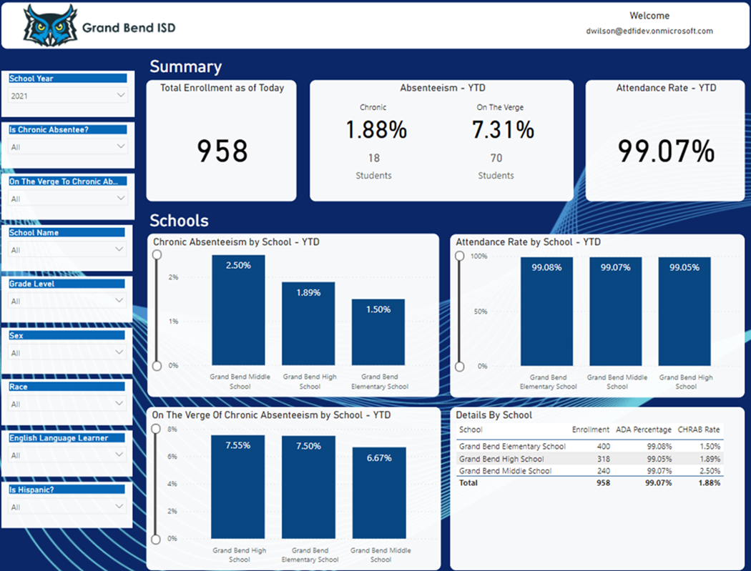
Chronic Absenteeism Dashboard - District
Notes:
For district level analysis a user would need to log in to the dashboard with a Superintendent role. The following few screenshots are for David Wilson, Superintendent of Schools at Grand Bend ISD.
User Story 1: As a Superintendent or district central office staff member, I want to monitor enrollment, attendance, and chronic absenteeism data across schools in my district, so I can work with campus leaders to address the challenges to impacted students and families. I may also want view chronic absentee rates across different campuses, so I can tailor support strategies and allocate resources as needed.

Slide 5
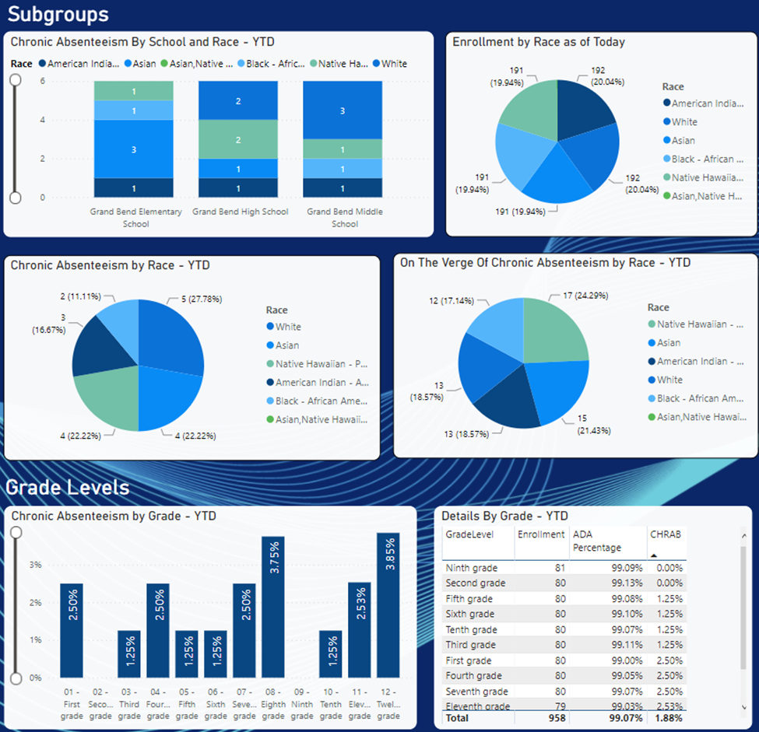
Chronic Absenteeism District Dashboard - Subgroups
Notes:
As district leader, I am concerned with equitable student support, where the needs of underserved and at-risk populations are addressed and not impacted by chronic absence or loss of instructional time. My absenteeism data can be viewed through various dimensions such as demographics, subpopulations, and grade levels. I can use these views to compare, contrast, and identify patterns or insights in my chronic absenteeism data in order to align resources and support most equitably and effectively. These charts and data tables are all clickable, to highlight a certain portion of the data, to sort columns the way I need them displayed, or other ways to make the data insights leap off the page for my and my staff's use.

Slide 6
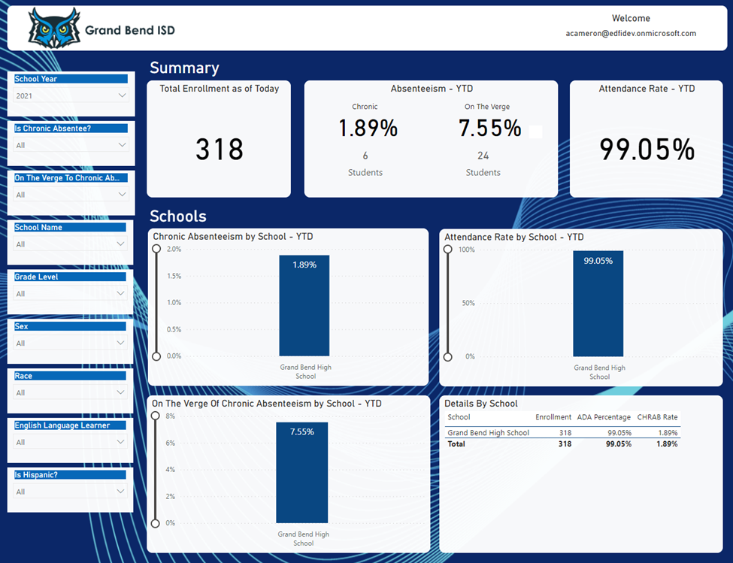
Chronic Absenteeism School Dashboard
Notes:
For school level analysis, a user would need to log in to the dashboard with a principal role. The next few screenshots are for Alisa Cameron, Principal at Grand Bend High.
User Story 2: As a Principal, I want to be able to quickly ascertain my campus levels of chronic absenteeism (or are students in my school trending toward chronic absence), and which of my individual students are at risk for chronic absenteeism, so that I intervene directly and equip my staff members to engage and support these students.
As I use the data, I quickly see in updated tiles:
Total student enrollment for my campus
Percentage of my chronically absent students (and actual number) per my district's attendance policies
Percentage of students on the verge of chronic absenteeism (5% toward the overall 10% threshold of instructional time missed)
Overall attendance rate for my campus
I can also rapidly scan to see comparative data across school campuses and grade levels to help me visually identify patterns and outliers. I can filter the data showing in the tiles and graphs on this page to tune it to what is most useful to me.

Slide 7
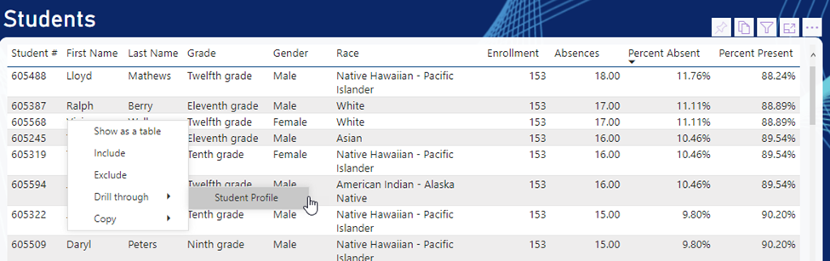
Chronic Absenteeism School Dashboard - Students
Notes:
Now that I understand what's happening overall at my school, I can drill down into the specific students or groups of students who need attention and help from me and my staff.
I can see a student's profile by right-clicking on their name in the Students table. This will show a menu over which I can hover to "Drill through" to select the Student Profile.

Slide 8
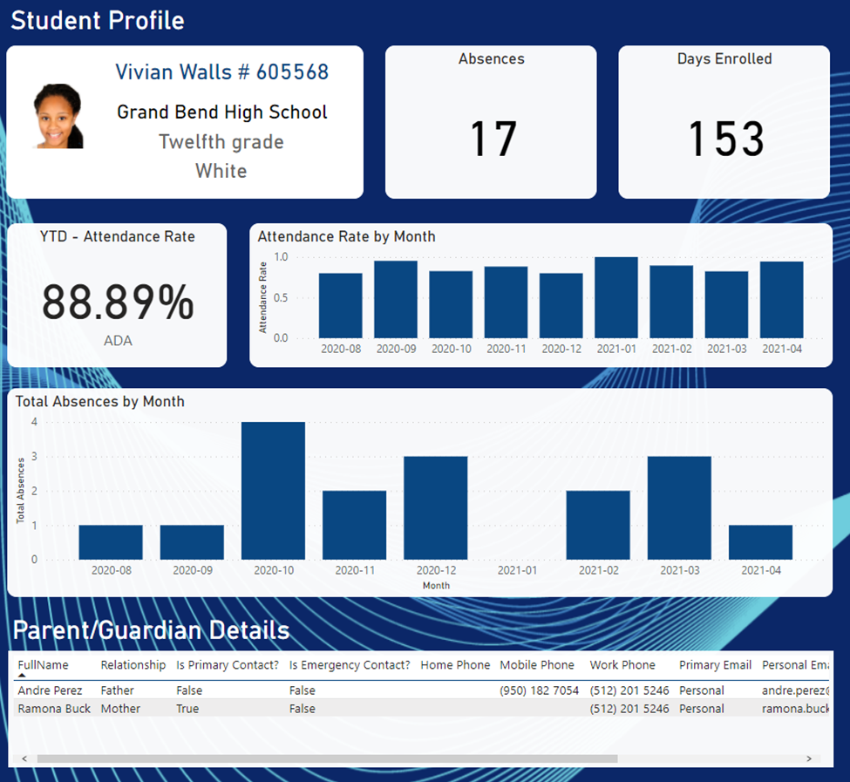
Chronic Absenteeism School Dashboard – Student
Notes:
And then I can learn specific aspects of an individual student's attendance and absence data, but also patterns such as the distribution over months of the school year. This could help me understand if it's an ongoing or new problem, or other insights to help me intervene effectively to support the student and their family.

Slide 9
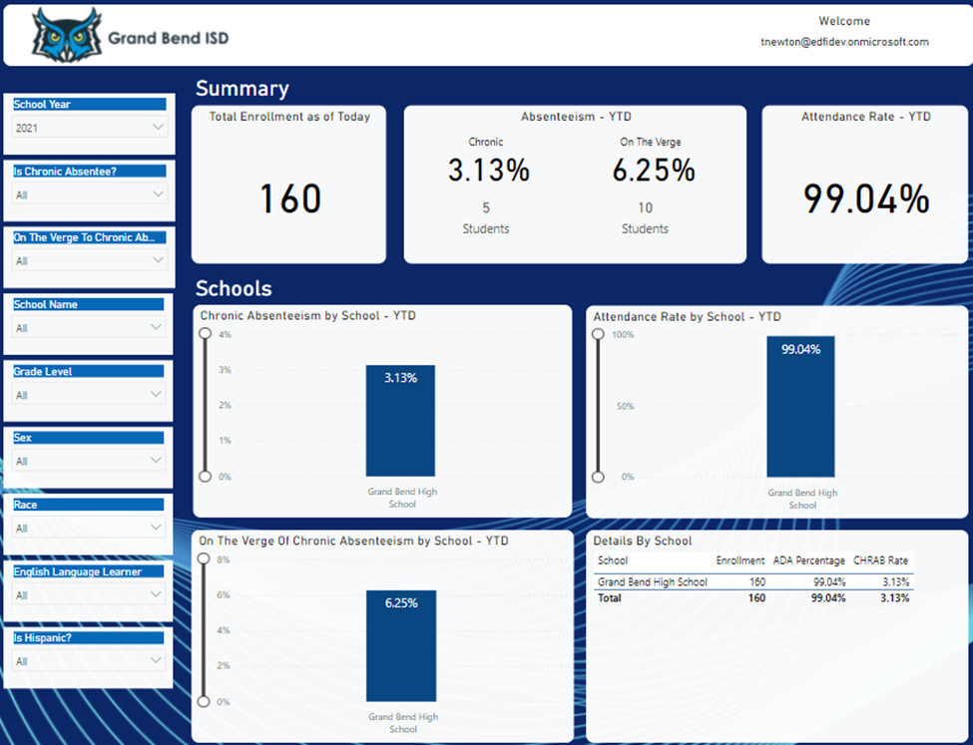
Chronic Absenteeism Teacher Dashboard
Notes:
For classroom/teacher-level analysis, a user would need to log in to the dashboard with a teacher user role. The next few screenshots are for Trent Newton, teacher at Grand Bend High.
User Story 3: As a Teacher, I want to be able to quickly view current attendance and absences data trends for students in my classes, so that I know as early as possible if my students are missing instructional time with me and how much that is occurring so that I can contact them or their parent/caregiver, scheduled a parent-teacher conference, or ask my campus leadership for support with the student and their family.
In my initial view I can see the number of students enrolled across my classes.
I see the percentage of those students and the actual number of them who are already chronically absent (missing >10% instructional time in the school year) so I can intervene with them and their family and caregiver to support them.
Importantly, I see the percentage and number of students "on the verge" of chronic absence, at 5% missed instructional time, to help me course correct in time to engage those students proactively to keep them from becoming chronically absent

Slide 10
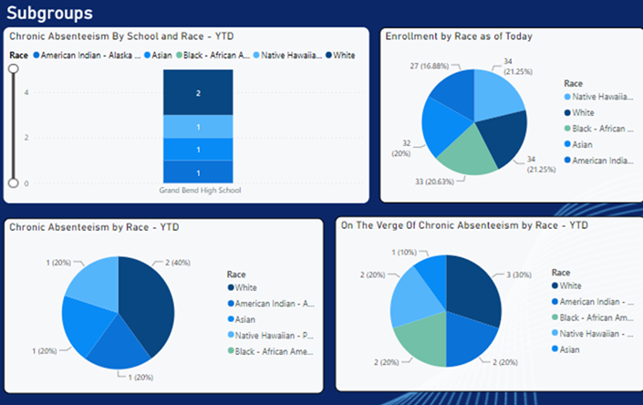
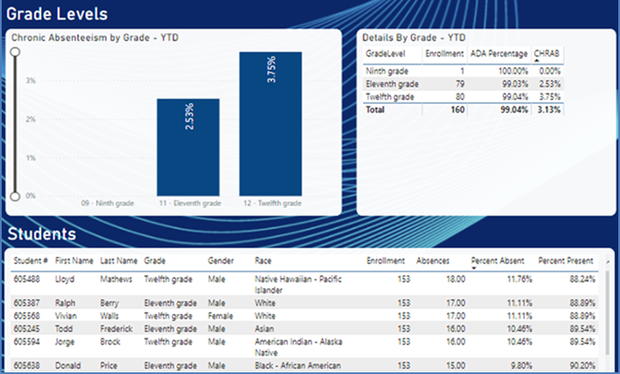
Chronic Absenteeism Teacher Dashboard – Subgroups
Notes:
As a teacher, I can use this data and the insights provided in the charts and visualizations to assess whether certain trends are occurring with any of the demographic subgroups or grade levels of my students. I also have access to detailed data tables that allow me to drill down to specific students for focused intervention and to better understand trends in their attendance and absence from the instructional time I have with them.

Slide 11
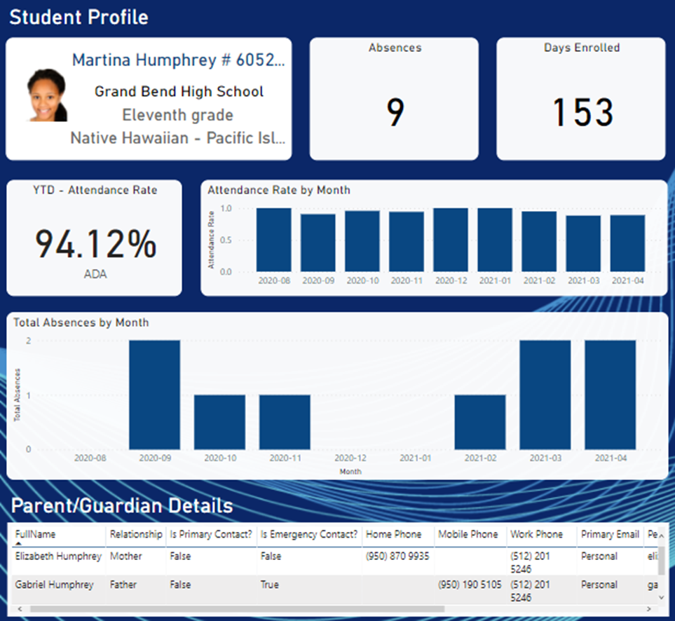
Chronic Absenteeism Teacher Dashboard – Student
Notes:
As I identify a certain student from the Students data table, I can right-click their name, choose Drill Through, and Student Profile. This provides more specific information and trend data for that student to give me a current and historical picture from this school year. Additionally, the Student Profile lists parent/caregiver contact information which, when combined with the student data, allows me to make an informative, productive phone call or email with the student and their caregiver.

Slide 12
Assessment Dashboards
The Assessment dashboard starter kit includes data visualizations for staff such as counselors, instructional coaches, and administrators. The dashboard helps stakeholders answer questions such as “Are students improving over time?“
The visualizations present multiple measures of assessment data in one view that shows how the student is performing by subject area or learning standard.
The dashboard is powered by data via certified API connections or published mappings (e.g. Data Import). Visualizations are from various assessments, including multiple summative, interim, or other benchmark assessment tools, to get a multifaceted view of student progress.

Slide 13
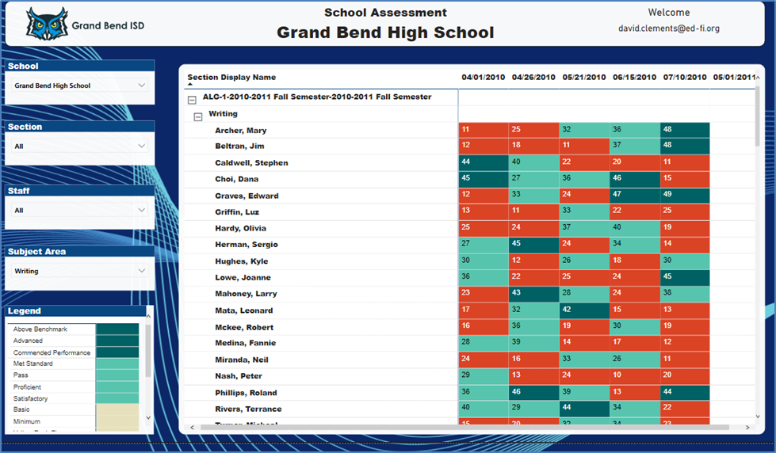
Assessment Dashboards - District
Notes:
For school / staff analysis, a user would log in to the dashboard with a district role. The following screenshot is for David Wilson, Superintendent at Grand Bend ISD.
Use Case 1: As a District Administrator, I want to be able to see how our students are performing and identify any areas where students may not be translating their skills. I will want to look at populations within the district that need intervention.
I can quickly see normalized performance level information across the student body over time. The color coded results based on Ed-Fi's standard performance level options help to quickly categorize overall performance while the individual scores give me context within the specific assessment.

Slide 14
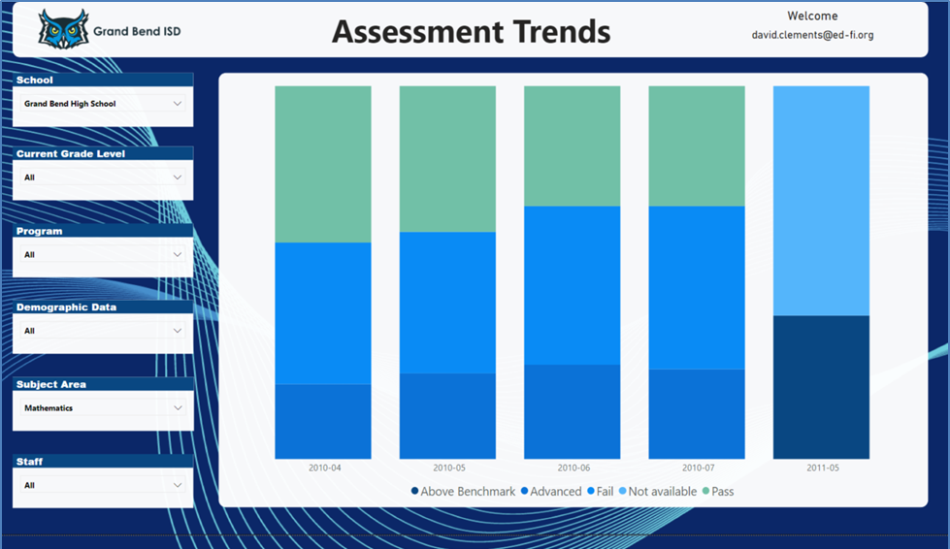
Assessment District Dashboard - Trends
Notes:
For trend analysis, a user would log in to the dashboard with a district role. The following screenshot is for David Wilson, Superintendent at Grand Bend ISD.
Use Case 2: As a District Administrator, I want to be able to see how our students are performing and identify any areas where students may not be translating their skills. I will want to look at populations within the district that need intervention.
As an administrator, I can move over to the Trends tab to see how different groups are performing over time. This gives a quick visual of the breakdown of students by performance level over time. I can use the filters on the left to inspect different student populations within the district. The Staff and Subject Area filters help me check how students are performing in their core subjects as well as in relation to support provided by staff.

Slide 15
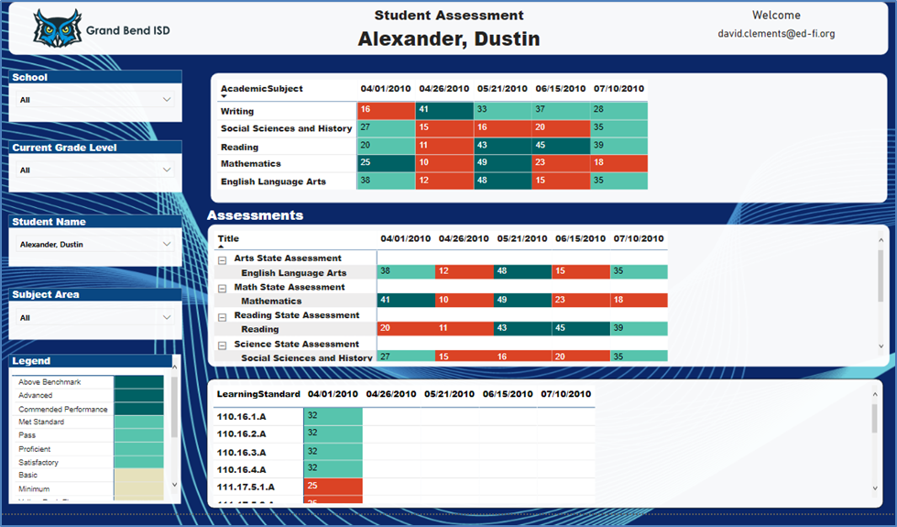
Assessment School Dashboard – Student Analysis
Notes:
For student analysis, a user would log in to the dashboard with a principal role. The following few screenshots are for Chadwick Garner, principal at Grand Bend Elementary.
Use Case 1: As a Principal, I want to be able to see trends for my school and identify students that need intervention.
After looking at the trend information for my school I will also want to drill down into individual students to see how they are performing. There are three areas I'll want to look at regarding student performance:
Across subject areas
Based on our defined learning standards
Based on individual assessments
This information will help me understand how students are performing and correlate their results in each specific context for student outcomes.

Slide 16
Family Portal Dashboards
The Family Portal dashboard starter kit provides a modularized website or portal for both family members and teaching staff to gain quick access to a student's profile. In this portal, a parent or guardian can see information about each student under their supervision. Staff will see an overview of each of their assigned course sections and detail on each student. For all users, the portal will allow communication with each other as questions arise.

Slide 17
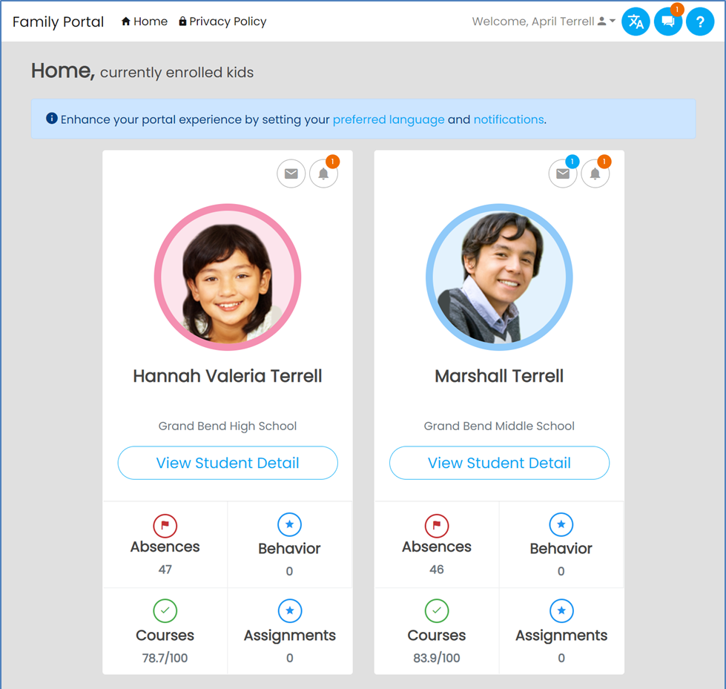
Family Portal Dashboard – Parent/Guardian
Notes:
User Story - As a parent or guardian, I want to be able to see at a glance how my children are doing in their classes, and whether there are any concerns to keep track of or discuss with their teachers.
Use Case 1 - Parent Home View: Once a parent/guardian authenticates with the portal, they will see their students' status and any relevant alerts in their home/preferred language.

Slide 18
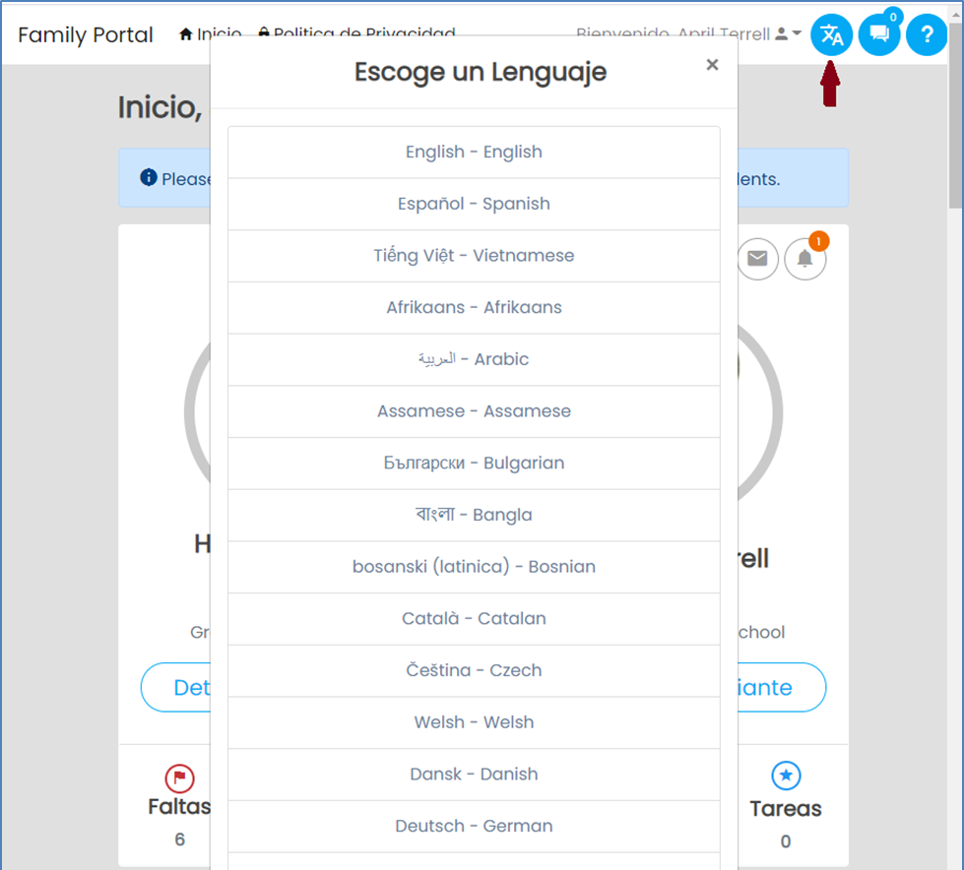
Family Portal Dashboard – Language Choice
Notes:
Use Case 2 - Change Language: The portal allows a user to select their language of choice. Selecting the Language icon on the top right allows them to choose and automatically refresh the portal.

Slide 19
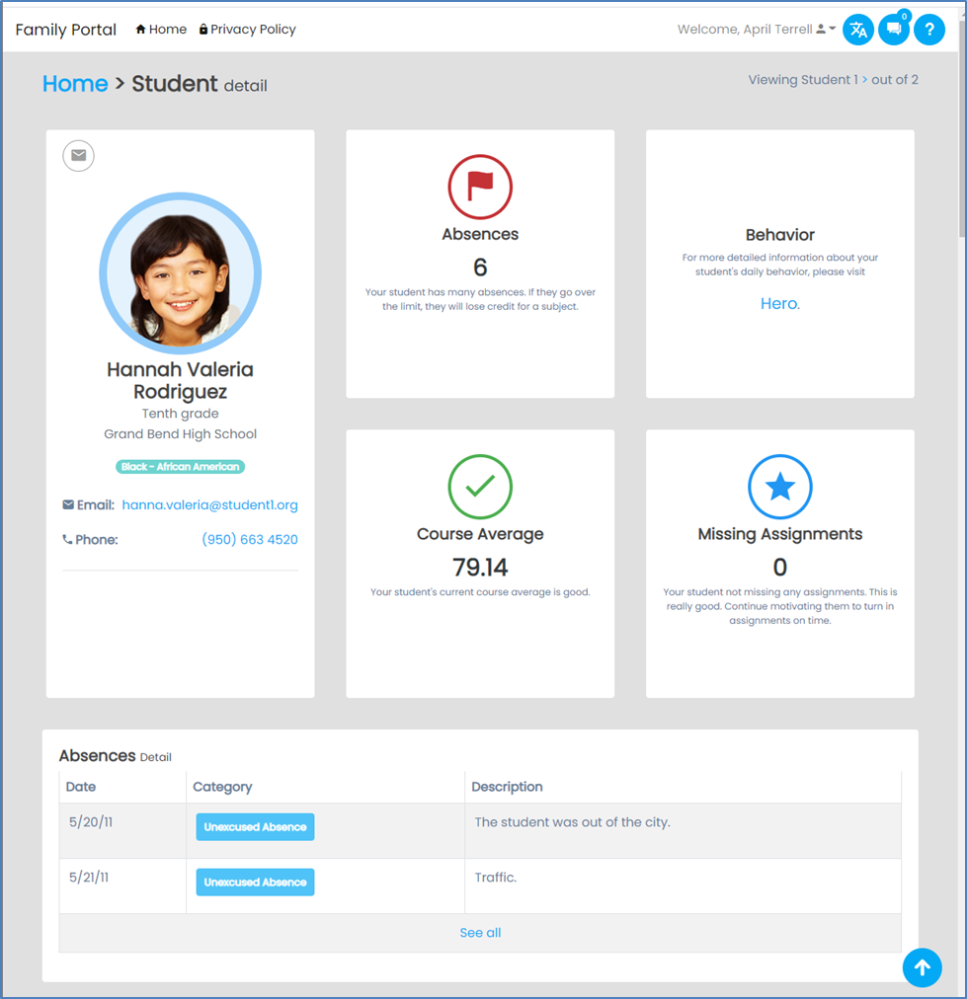
Family Portal Dashboard – Student Details
Notes:
Use Case 3 - View Student Detail: Parents/guardians can view their student's key status details at a glance. This summary view includes absences and whether the student has reached a threshold of concern, behavior notices and relevant actions, overall course grade average, and any missing assignments from any of their enrolled courses.

Slide 20
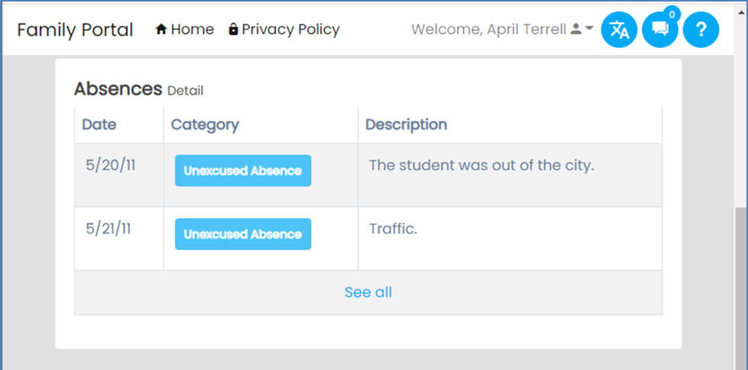
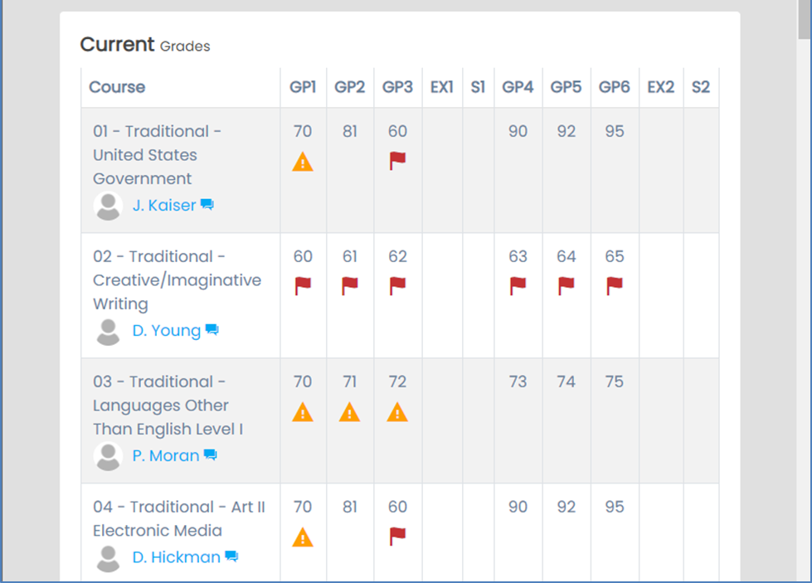
Family Portal Dashboard – Absences/Grades
Notes:
View Student Detail - Absences/Grades/Indicators: Parents/guardians can review recent absences along with notes about those absences from school staff. They can also see grades and indicators for each available grading period across sessions/semesters, including end of course exams.

Slide 21
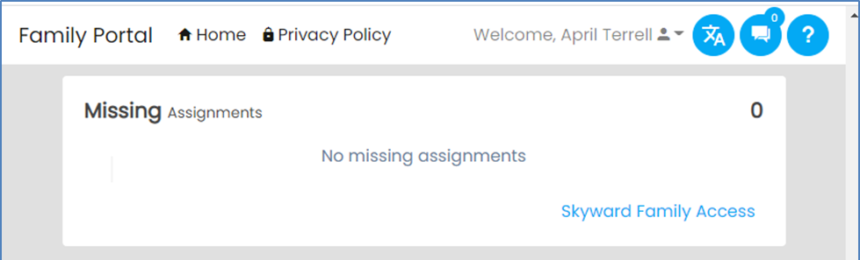
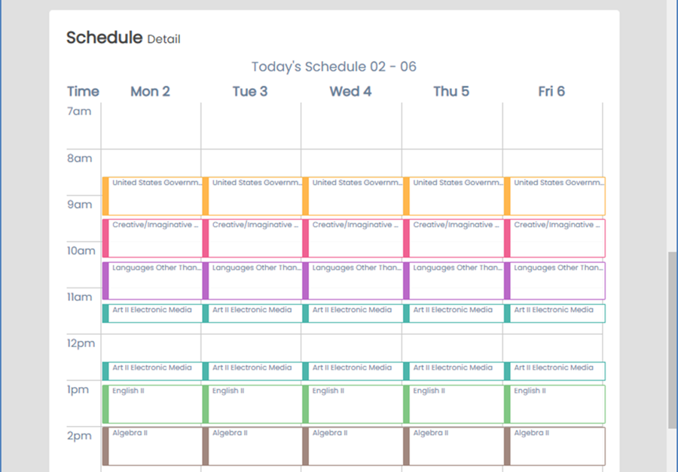
Family Portal Dashboard – Assignments/Schedule
Notes:
View Student Detail - Student Assignments/ Student Schedule: Parents/guardians can see more detail of the missing assignments from each of their current courses. In addition, they can see their student's schedule in a calendar timeline.

Slide 22
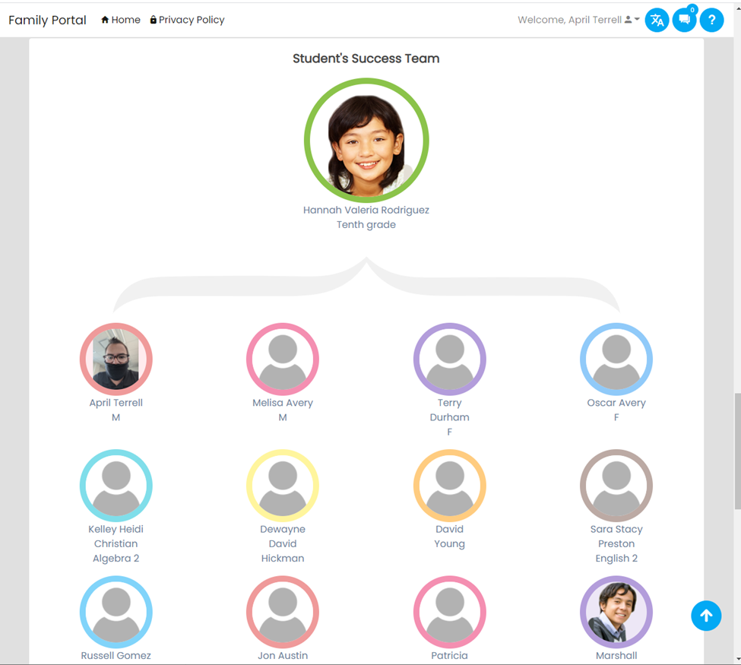
Family Portal Dashboard – Staff Team
Notes:
View Student Detail - Staff Team: Parents/guardians can see an overall view of teachers and staff who interact with their student.

Slide 23
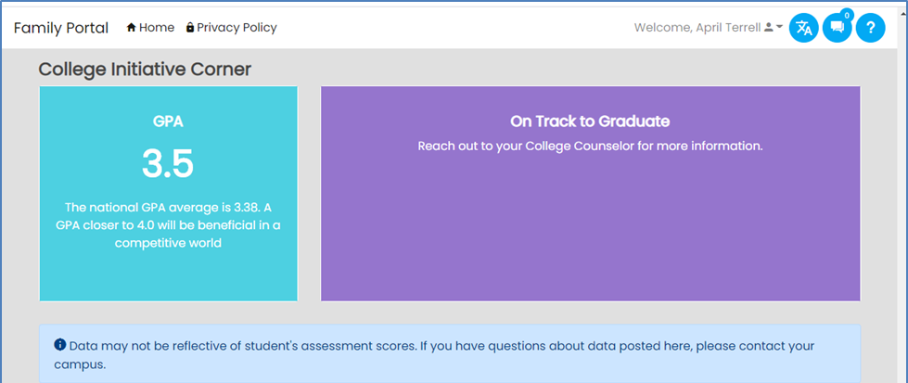
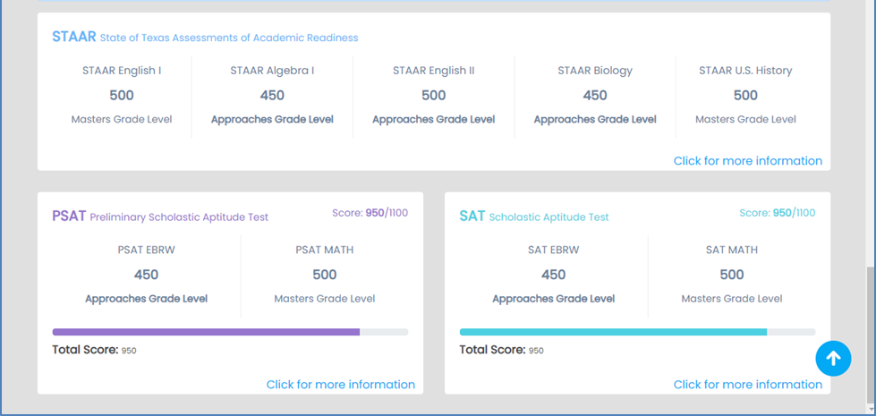
Family Portal Dashboard – On Track
Notes:
View Student Detail - On Track Dashboard: Parents/guardians can track their student's progress.

Slide 24
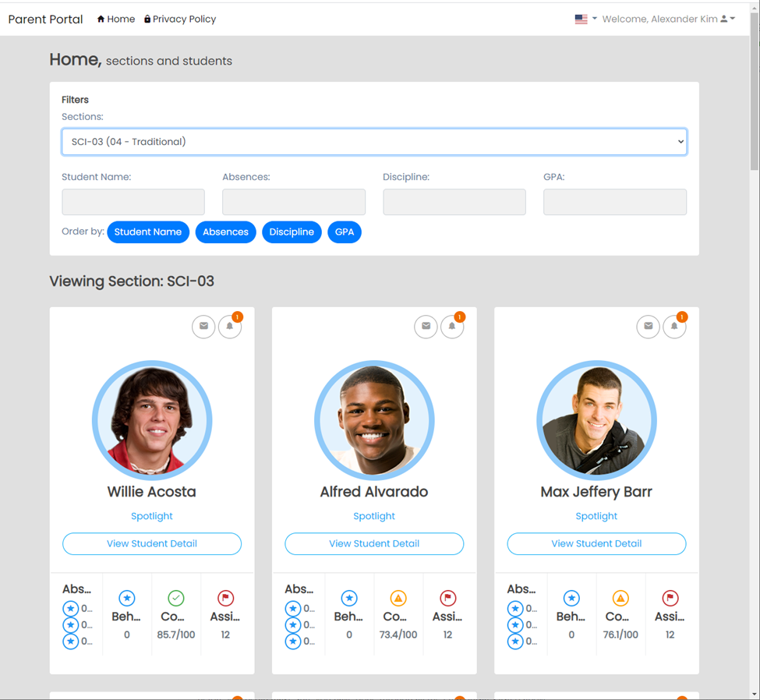
Family Portal Staff Dashboard – Search
Notes:
User Story - As a teacher or other staff assigned to work with students, I want to be able to view students in each of my classes (course sections) and keep track of their concerns.
Staff Use Case 1 - Staff Section Search: Once logged in, teaching staff are presented with an interface where they can choose their sections or search for specific students:

Slide 25

Family Portal Staff Dashboard – Student View
Notes:
Staff Use Case 2 - Student View: Staff are able to see the same view of student detail as shown in the Family Portal section above.

Slide 26
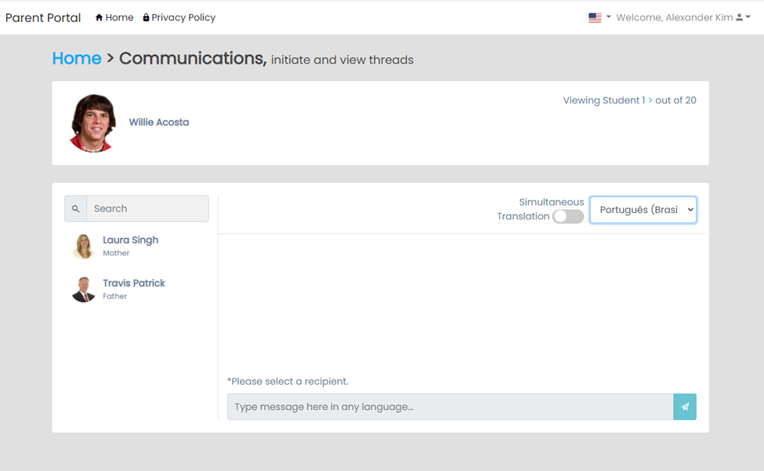
Family Portal Staff Dashboard – Messaging
Notes:
Staff Use Case 3 - Message with Student or Family Members: The portal allows staff to search for students and their parents or guardians, and then communicate with them via your organization's official channels.

Slide 27
Contact Information
Dan Ralyea
Director
Office of Research & Data Analysis
South Carolina Department of Education
1429 Senate Street; Columbia, SC 29201
DRalyea@ed.sc.gov
(803) 734 – 8086

Slide 28
References
Ed-Fi Alliance - https://www.ed-fi.org/what-is-ed-fi/​
TechDocs - https://techdocs.ed-fi.org
Ed-Fi Starter Kits - https://techdocs.ed-fi.org/pages/viewpage.action?spaceKey=SK&title=Starter+Kits
Technical Suite Matrix – https://techdocs.ed-fi.org/display/ETKB/Ed-Fi+Technical+Suite+Version+Matrix
Ed-Fi Technology Roadmap - https://techdocs.ed-fi.org/display/ETKB/Ed-Fi+Technology+Roadmap
Ed-Fi Academy - https://www.ed-fi.org/academy/
Ed-Fi Unifying Data Model Handbook - http://schema.ed-fi.org/datahandbook-v30/Ed-Fi-Handbook-Index.html#/

