Slide 1
Ed-Fi in South Carolina
What is Ed-Fi? Why should I integrate data?

Slide 2
Questions We’ll Answer Today
The Why
Why data standards?
Why interoperability?
Why Ed-Fi?
The What
What is Ed-Fi (and all these acronyms)?
What does this look like?
What is involved in data system mapping?
The Now What
How can Ed-Fi be customized?
What can be built using Ed-Fi?
What can I do with Ed-Fi?

Slide 3
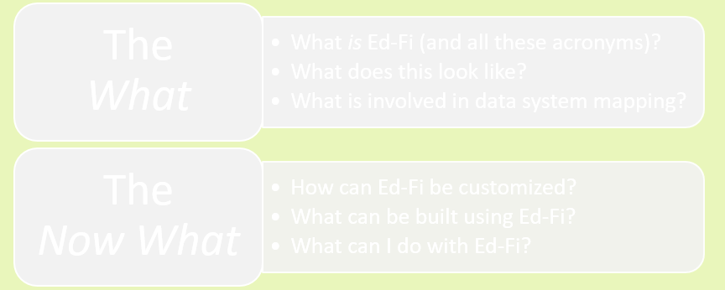
Questions We’ll Answer Today
The Why
Why data standards?
Why interoperability?
Why Ed-Fi?

Slide 4






Why Data Standards?
Ultimate Goal
Data standards create consistency across:
Governance regions (states, districts)
Time (school years, marking periods)
Systems (gradebooks, SISs)
A computer that can read a dataset across these domains, with no human involvement
Data standards allow us to:
Connect data from different systems
Combine data into a single usable system
Create efficiencies that minimize manual data wrangling
Powerful… but just a prerequisite for more interesting things

Slide 5



Why Interoperability?
Interoperability is about data organization and interchangeability across multiple systems
I am tired of yanking Excel files and combining them! Can’t I have my SIS data and my Assessment data in the same spot—automatically?!
If I change vendors, is my entire data workflow and reporting system broken?!
These two things require all source systems to adhere to some type of data standard.

Slide 6


Why Ed-Fi?
Problem
Solution
Interoperability transport layer
Provides transport & integration layer
Too many source systems
Standards-based system
Proprietary source systems
Open-source technology
Cloud-based source systems (not in-network)
API native system
Desire from funders to conform to API transport spec
Standards-based system

Slide 7


Questions We’ll Answer Today
The What
What is Ed-Fi (and all these acronyms)?
What does this look like?
What is involved in data system mapping?

Slide 8
What are the components of the Ed-Fi platform?
Ed-Fi Data Standard
Ed-Fi Operational Data Store (ODS)
Ed-Fi Application Programming Interface (API)
Ed-Fi API/ODS Admin App

Slide 9


Ed-Fi Data Standard
Ed-Fi Data Standard
A set of rules that establish a unified structure and format for K-12 educational data
A universal standard,
not specific to any one education agency
Encourages interoperability between data sources
Discipline
SIS
Gradebook
Finance
Assessments
Food Services
etc.
Notes:
https://techdocs.ed-fi.org/display/EFDS32

Slide 10


Ed-Fi Operational Data Store (ODS)
Ed-Fi Operational Data Store (ODS)
Where data for Ed-Fi is captured and stored
Normalized Data Structure
Reads and writes data faster, increasing speed
But not optimized for analytics or reporting
Transactional in Nature
Designed to capture only transactional data
Though some analytic data (Ex: grad rate) can be stored, it’s a poor fit

Slide 11




Ed-Fi Application Programming Interface (API)
Transforms data from the ODS into a format readable by humans
Allows easy and convenient access to extract the contents from the ODS (versus direct access to a database)
Makes ODS data consumable for applications and analytics
Authorizes which applications can see or manipulate data
Ed-Fi Application Programming Interface (API)
How users interact with the Ed-Fi ODS

Slide 12

Ed-Fi API/ODS Admin App
Ed-Fi API/ODS Admin App
A User Interface (UI) used to manage and administer the API/ODS

Slide 13
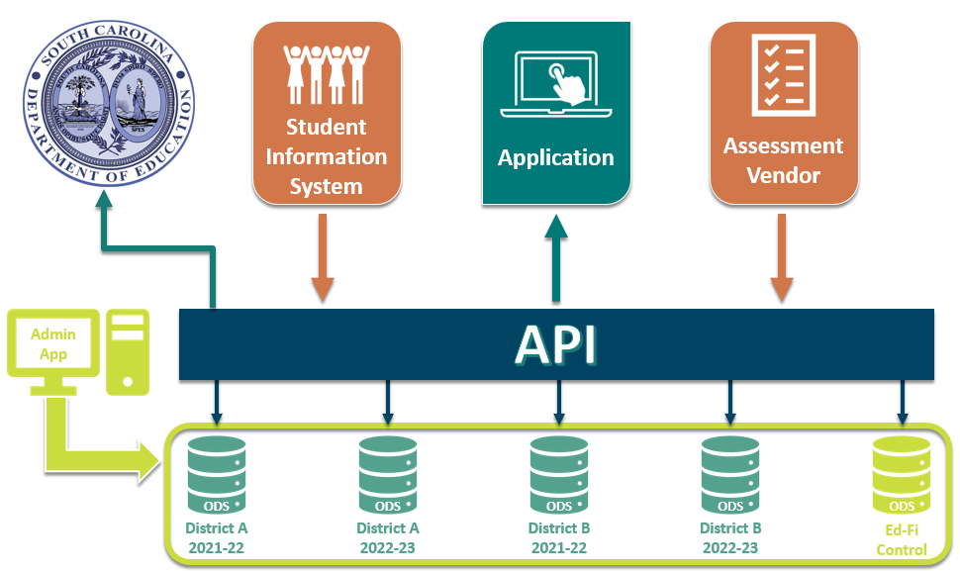
What does this look like?

Slide 14
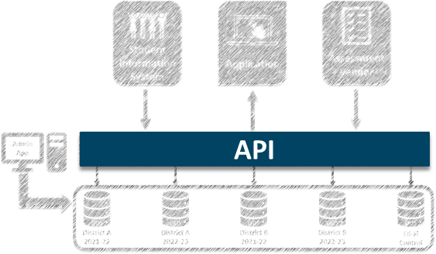

What is Involved in Data System Mapping?
Systems that are Ed-Fi certified must interact with the ODS through the API only
To make this work, two kinds of mapping need to happen:
System Mapping This is the source system vendor’s responsibility
Descriptor Mapping This is the education agency’s responsibility

Slide 15
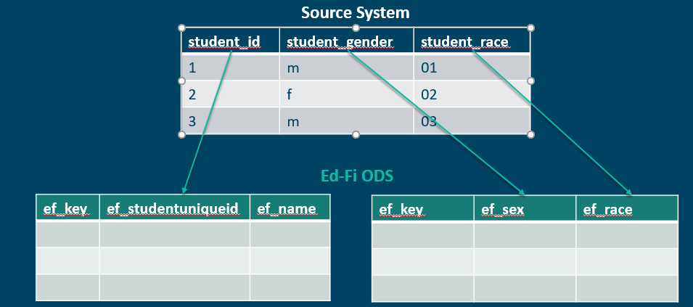
System Mapping
(The source system vendor’s responsibility)
System Mapping is figuring out where all of the data from your source systems need to “live” in the Ed-Fi ODS.

Slide 16
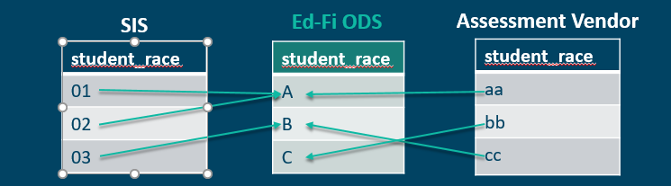
Descriptor Mapping
(The education agency’s responsibility)
Descriptor Mapping is translating the codes, or values, used in your source systems to universal codes in the Ed-Fi ODS
First, need to decide on what values the ODS will use
A big governance step
Likely requires buy-in from multiple stakeholders
Decides the “source of truth”
Then, need to map the source system to ODS via a source tool.

Slide 17
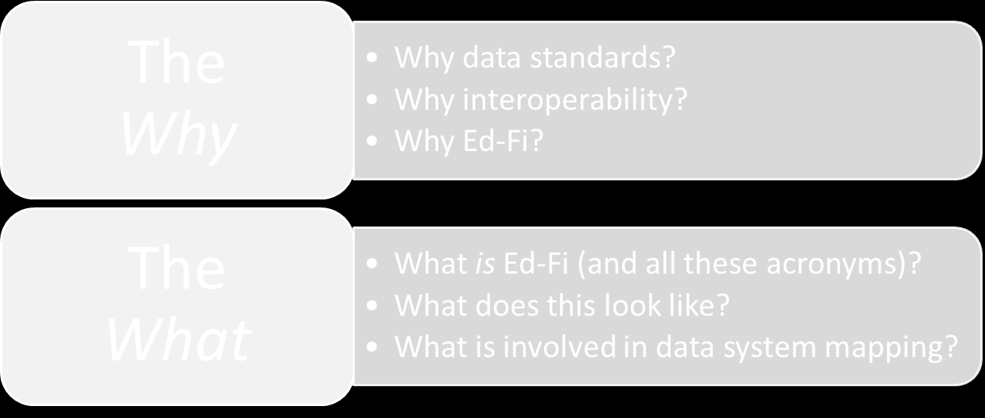
Questions We’ll Answer Today
The Now What
How can Ed-Fi be customized?
What can be built using Ed-Fi?
What can I do with Ed-Fi?

Slide 18
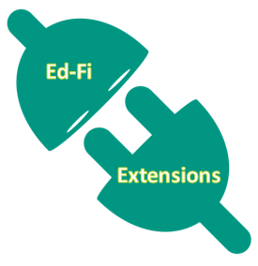
How can Ed-Fi be Customized?
Ed-Fi can be customized to handle additional kinds of data (with some effort) via Ed-Fi Extensions.
Ed-Fi Core Domains will already include data about:
Teachers
Students
Classrooms
Assessments
Ongoing efforts within the Ed-Fi Community to build extensions
All non-state reporting-related extensions to be governed by DDGG

Slide 19
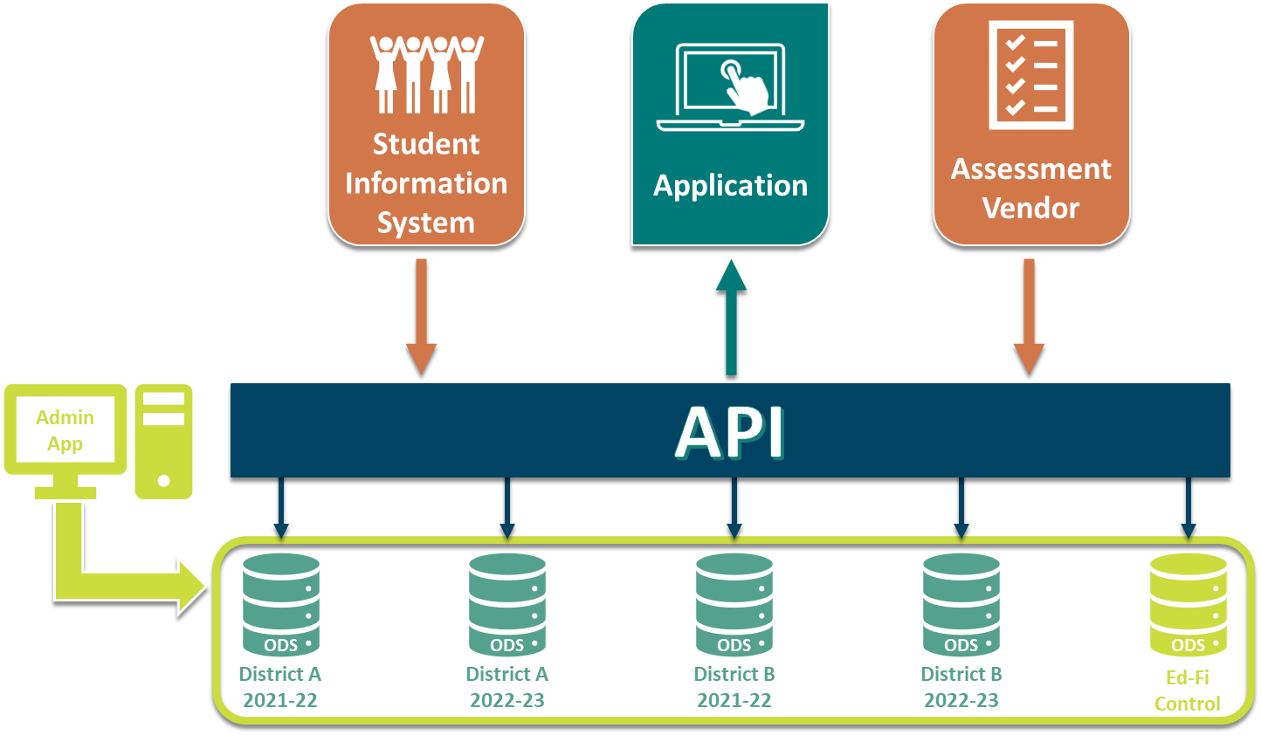
How can Ed-Fi be Customized?
Example: What if I want to add my bus schedule?
Need to modify how the API communicates to/from the ODS
Need to add data tables to ODS
Notes:
There's a domain for bus schedules, but you wouldn’t have it installed.
If everyone says, “we all want to write bus schedules to this,” then you can extend the central repository to allow for that--but it's hard.
Instead of building an application, it's about establishing the data model inside the structure.

Slide 20
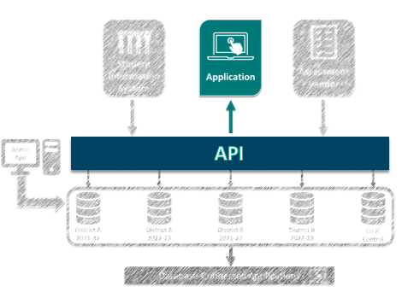
What can be Built using Ed-Fi?
API-Based Applications
Only require data from the API itself
API is much more stable for development purposes
Very granular security model

Slide 21
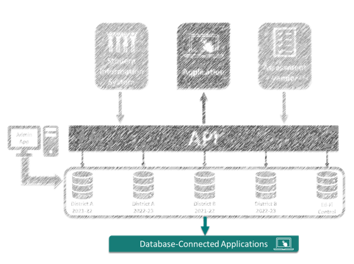
What can be Built using Ed-Fi?
Database-Connected Applications
Exist behind the API
Required to be on the same network as the ODS
Direct database connection requirement makes end user access insecure
Data model changes break applications

Slide 22
What can be Built using Ed-Fi?
Database-Connected Applications
State infrastructure will not support individual districts deploying these applications
A district could deploy their own Ed-Fi instance if they want this functionality
DDGG can decide to develop and install an application on the database to be made available to all districts at the same time

Slide 23
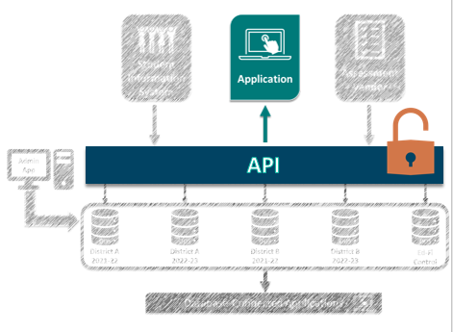
What can I do with Ed-Fi?
All South Carolina districts will have full API access
Districts can give access to different applications:
Vendors’ applications
Internal user applications
Internal API-connected data warehouses

Slide 24


What can I do with Ed-Fi?
The API makes all combined data available to any vendor (or internal group) with a unique identifying “key” and “secret” encryption
An ecosystem of applications is being built on top of the Ed-Fi API
Case Study:

Slide 25
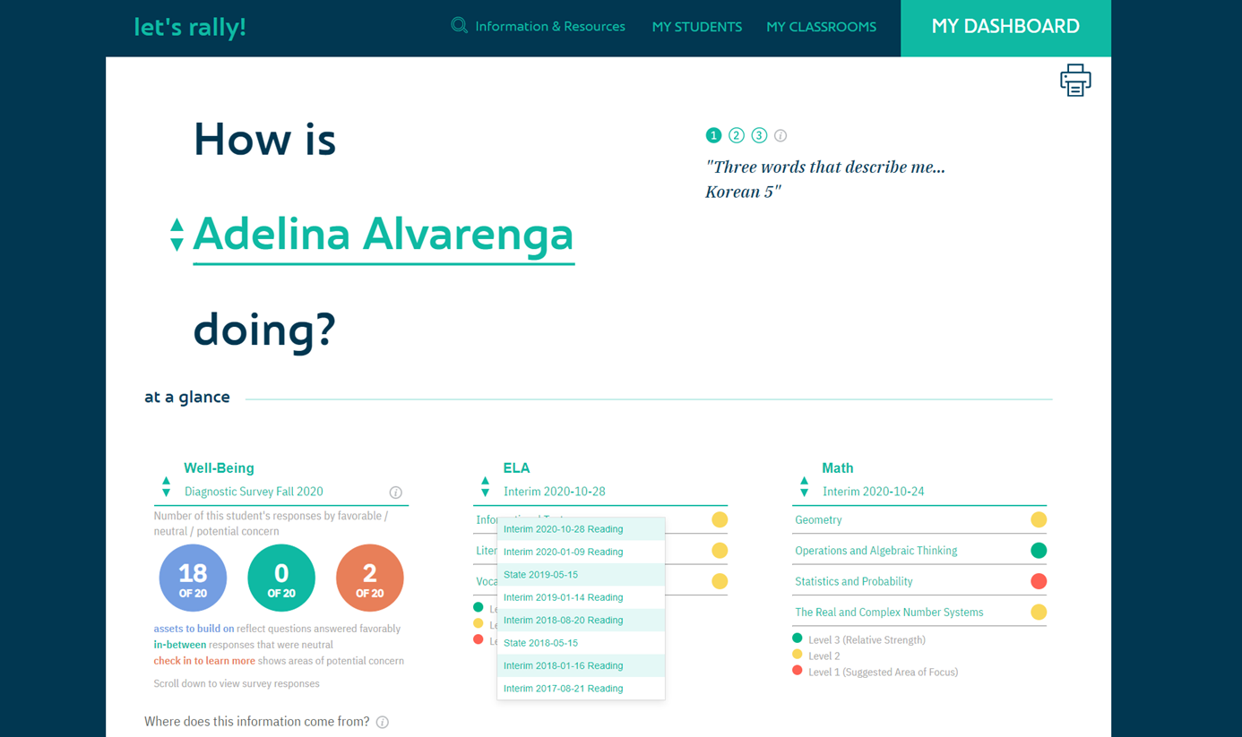
Rally Platform

Slide 26
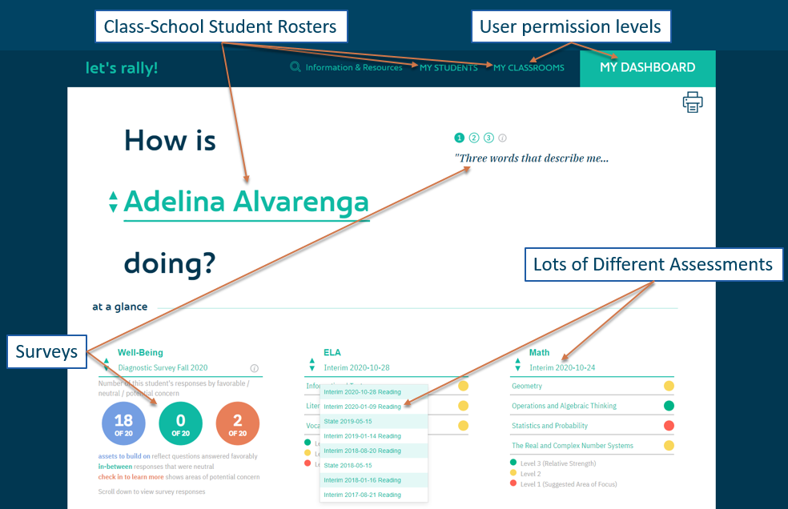
Rally Platform

Slide 27
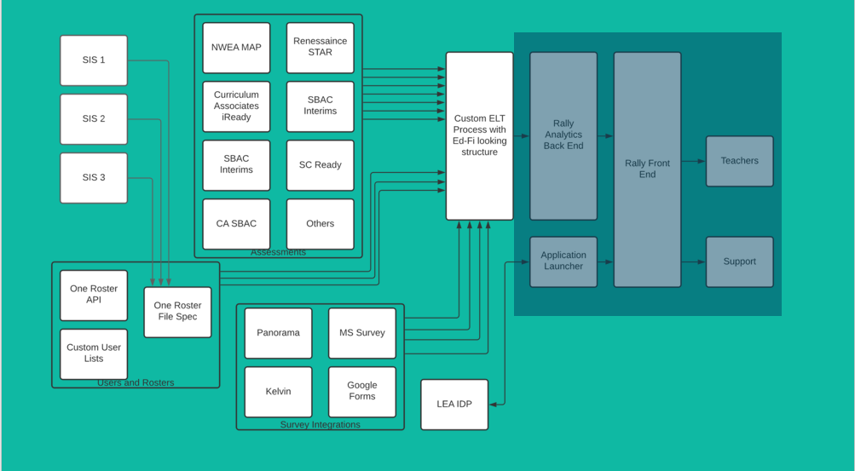
Overwhelming Data Integration Problem™
9/14/2021
27

Slide 28
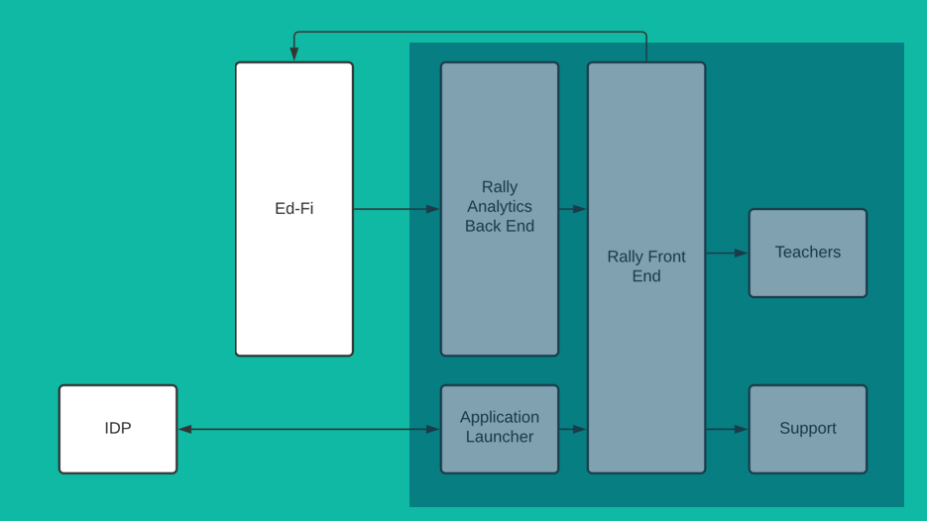
Ideal State (Ed-Fi Easy Button)
9/14/2021
28

Slide 29
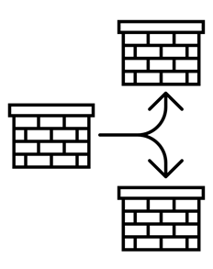


What can I do with Ed-Fi?
Any application a district builds on the Ed-Fi API could be replicated to another district
Analytics data stores can be stood up through the API (and BI tools built on top of these)
Fast integration of vendors who are Ed-Fi compliant
Notes:
Any application a district builds on the Ed-Fi API could be replicated to another district
For free? District collaboration becomes much easier.
Analytics data stores can be stood up through the API
BI tools on top of these can be designed and replicated to any colleague district very quickly
Fast integration of vendors who are Ed-Fi compliant
Rosters are a quick win, more data integrated increases value
Real time assessment vendor rostering

Slide 30

Questions?
Notes:
Any application a district builds on the Ed-Fi API could be replicated to another district
For free? District collaboration becomes much easier.
Analytics data stores can be stood up through the API
BI tools on top of these can be designed and replicated to any colleague district very quickly
Fast integration of vendors who are Ed-Fi compliant
Rosters are a quick win, more data integrated increases value
Real time assessment vendor rostering

Slide 31
Additional Resources
If you do not yet have a registered Ed-Fi Account, please get one here: Create an Account
You will gain access to tech docs, slack channel, git repositories, and Alliance ticketing system
The Ed-Fi Exchange is a great resource to find how other organizations create solutions for their data needs: Ed-Fi Exchange

Slide 32
Contact Information
Education Analytics
110 E. Main Street, Suite 1000 Madison, WI 53703
(608) 466-4966
Notes:
Any application a district builds on the Ed-Fi API could be replicated to another district
For free? District collaboration becomes much easier.
Analytics data stores can be stood up through the API
BI tools on top of these can be designed and replicated to any colleague district very quickly
Fast integration of vendors who are Ed-Fi compliant
Rosters are a quick win, more data integrated increases value
Real time assessment vendor rostering

