Slide 1
Ed-Fi as the Data Nervous System at Every Level: The South Carolina State and District Ed-Fi Journey

Slide 2

Panel Objectives
Our panel will:
1. Describe SC’s Ed-Fi journey to date and where we are headed,
2. Share about our successes, challenges, and what we’ve learned, and
3. Engage with questions from attendees.

Slide 3




Session Panelists
Wyatt Cothran, SC Dept of Ed
Josh Findlay, SC Dept of Ed
Wendy Stephens, SC Dept of Ed
Andrew Rice, Education Analytics
Notes:
Josh

Slide 4
South Carolina’s Ed-Fi Vision
Collaborative Data Governance
Unique ODS/API infrastructure
Community buy-in and voice
Reduction in duplicated effort
Transparency
Data Nervous System

Slide 5
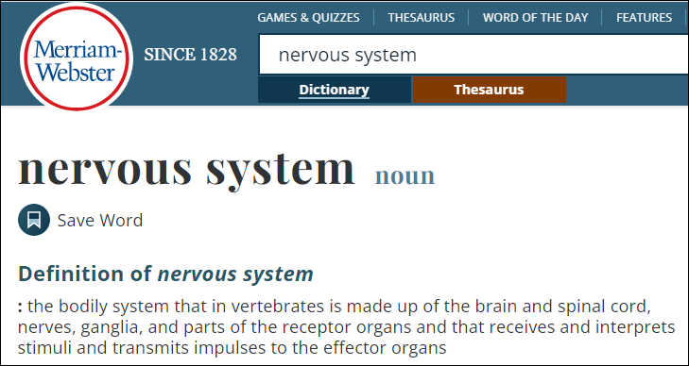
Nervous System

Slide 6

South Carolina’s Ed-Fi Vision - Collaborative Data Governance
Collaborative Data Governance SC’s data governance model is designed to facilitate collaboration between districts and the state in determining and clarifying who owns what data, as well as data stewardship practices.

Slide 7
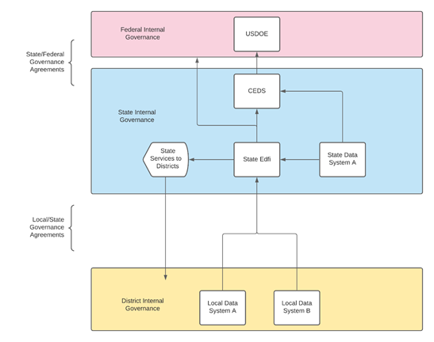
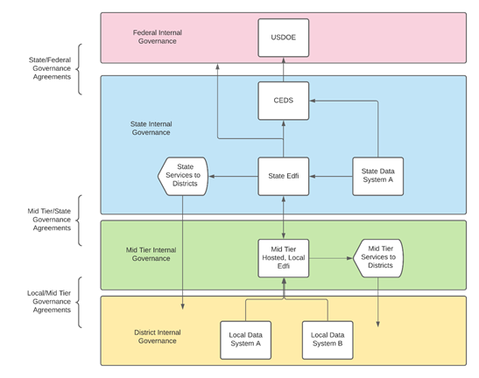
South Carolina’s Ed-Fi Vision – Governance Model
Standard Governance Model
Our Governance Model

Slide 8
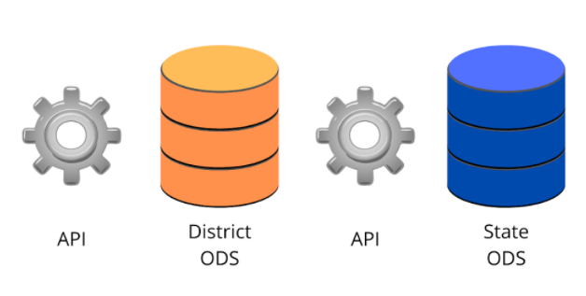
South Carolina’s Ed-Fi Vision - Unique ODS/API Infrastructure
Unique ODS/API Infrastructure SC’s ODS/API model includes a state-provided ODS for each district that sends certain data up to a state-level ODS. It is designed to:
bring together data from multiple systems more efficiently,
promote cleaner data snapshots, and
boost the scope of efforts that meet data needs voiced by districts, preventing duplication of development work.

Slide 9
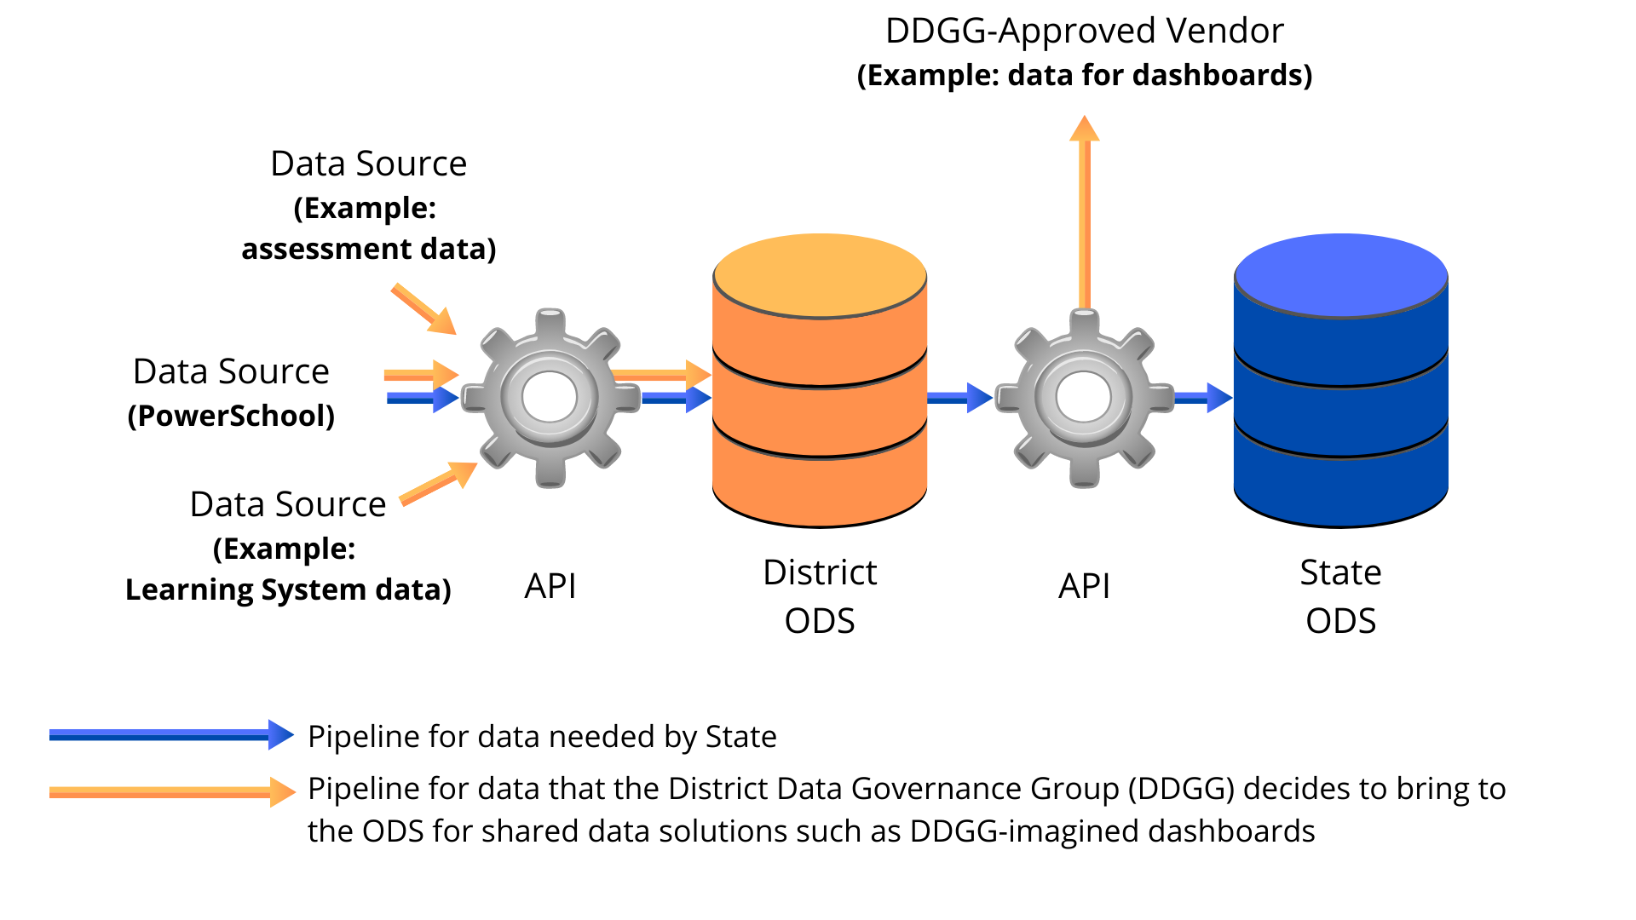
SC Ed-Fi Pipelines

Slide 10
South Carolina’s Ed-Fi Vision - Community Buy-in
Informational Series and Presentations with Key Partners Drive stakeholder understanding and set expectations
One-on-one Workshops Provide more nuanced view of Ed-Fi implementation with SIS
LEA-led Activities Encourage peer group discussions
Cross-agency Collaboration Prepare internal partners to structural change and expose to potential increased utility

Slide 11
Where we are in our journey
2020: Pilot phase
Among other goals, provided SCDE and SC pilot districts a general understanding of Ed-Fi, the ODS, data quality and mapping, and PowerSchool integration; info served as a reference point for all districts moving into statewide integration.
Spring, Summer, Fall 2021: Ed-Fi statewide integration (2020-21 district ODS)
Extended understanding and engagement statewide
Provided opportunities for large-group and one-on-one conversation
Present: Preparing for next Ed-Fi statewide integration (2021-22 district ODS)
Refining the API in preparation for 2021-22 connections to district ODS
Error identification and diagnosis

Slide 12
Successes - 1
High-level of LEA engagement and interest
Ed-Fi
Interoperability in general
Data collaborators instead of hierarchical agencies
Attendance data from SIS in the ODS
SIG around Chronic Absenteeism Report/Dashboard/Starter Kit
District Data Governance Group (DDGG)
Director hired; Charter, Bylaws, etc.
Subcommittee members nominated

Slide 13
Successes - 2
SC Implementation path enhances LEA flexibility and agency
A new blended model: combines centralized state Ed-Fi ODS & collaborative LEA Ed-Fi model
Meets the reporting & compliance needs of SEA while providing additional flexibility & utility for LEAs
LEAs choose to do the minimum required for state reporting, or to take advantage of a robust, standards-based data system to streamline & expedite their data collection and analytics
Cost savings for the LEAs
Privacy is maximized by retaining local flexibility & control

Slide 14
Challenges - 1
Overcoming fear of the unknown and establishing trust across all stakeholder groups
Mapping is not always easy, especially when your SIS has lots of customizations
Data validation is intrinsic to the API, something new for SC

Slide 15
Challenges - 2
Data governance requires both a broad perspective of the full educational ecosystem AND deep expertise in data & technology
Building a system that works for stakeholders at every level of the system means constantly weighing & balancing tradeoffs - and being willing to revisit decisions again and again to reevaluate those tradeoffs
To attain true local flexibility and control, the state must be willing to cede a lot of power and control for the greater good

Slide 16
What we’ve learned - 1
Counterintuitive to consider simplicity generates complexity
Many processes to (re)consider for near-term rollout and for the future (re)development
Statewide SIS did not always create mapping efficiencies - standardization is often a fallacy
Statewide SIS greatly enabled strong yet collaborative data governance
Community is important!

Slide 17
What we’ve learned - 2
It's only now viable to build a flexible, cloud-based Ed-Fi system to accommodate multiple districts (without incurring enormous costs) due to Ed-Fi's open source tech stack
Crucial for the mid-tier governance structure to be managed as a singular entity (not 80 individual LEAs with 80 separate connections from their local data system to the ODS)
Data governance is one of the biggest challenges in this work. It raises issues that are both big, philosophical and small, technical

Slide 18
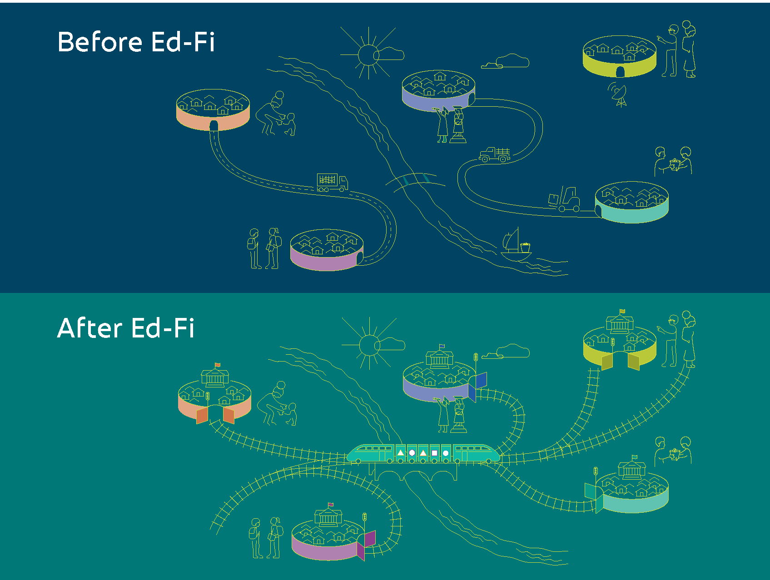
Pre-Ed-Fi Data Practices

Slide 19
South Carolina’s Ed-Fi Vision for the Future

