Slide 1
ORDA Office Hour
School Climate Surveys and Ecollect
February 16, 2023
Ellen Weaver
State Superintendent of Education

Slide 2

School Climate Survey Administration Dates
Monday, February 27, 2023
Submission window opens for Teacher, Student, and Parent Surveys.
Friday, April 14, 2023
Surveys close.
Dates clarified in this November memo.

Slide 3
School Climate Survey Ecollect Version
Ecollect Version Requirement
District PowerSchool Administrators must ensure that districts have been upgraded to Ecollect Forms 23.1.0.0. If this upgrade has not yet been completed, they should submit a PowerSchool support ticket to request the upgrade.
https://ed.sc.gov/data/information-systems/accountability-resources/climate-surveys-ecollect-forms/

Slide 4

Parent Survey
Administered through Qualtrics
Links to the Qualtrics surveys will be delivered to through Ecollect Forms accessible to parents through Parent Portal.
A PowerSchool import file containing the parent school climate survey links exists in the Technology Data Coordinator folder of the Advance Data Transfer (ADT) application. District PowerSchool Administrators should ensure as soon as possible that this file has been imported in PowerSchool. The titles of the csv file and the PDF containing the import instructions are clarified below:
1. Import File
The title of the PowerSchool import file is “survey_XXXX” and is dated 2/1/2023 (XXXX is the districtcode). It is a csv file.
2. Import Instructions
File import instructions also exist in the folder as a PDF file titled “Parent Climate Survey Link – Import Instructions for PowerSchool”

Slide 5
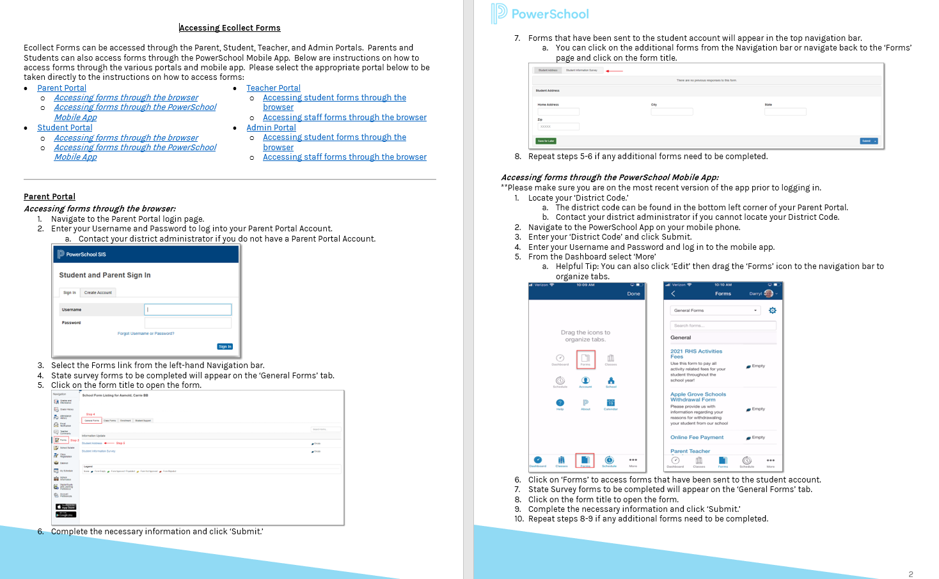
Parent Survey Links - Access through Parent Portal 1
Please see the Accessing Ecollect Forms document linked to from the SCDE
Climate Surveys & Ecollect Forms web page for instructions on how parent respondents can access their respective School Climate surveys.
Note that URLs for accessing PowerSchool portals (i.e., the PowerSchool Parent/Student Portal and Teacher Portal) vary from district to district.
Typically, in place of the word “admin,” Parent/Student Portal URLs include either the word “public” or “guardian,” and the word “teachers” is typically present in the case of Teacher Portal URLs.

Slide 6
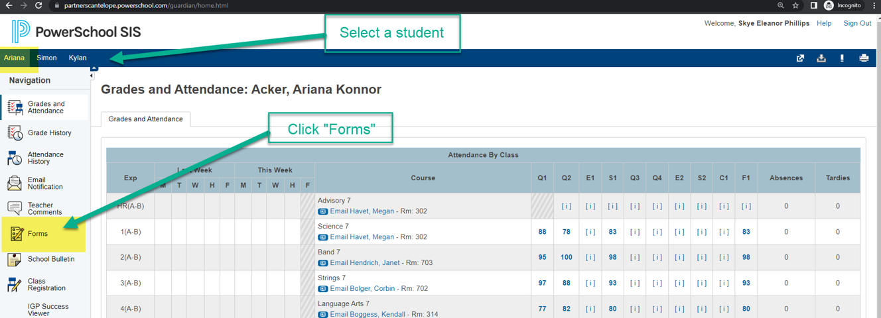
Parent Survey Links - Access through Parent Portal 2

Slide 7
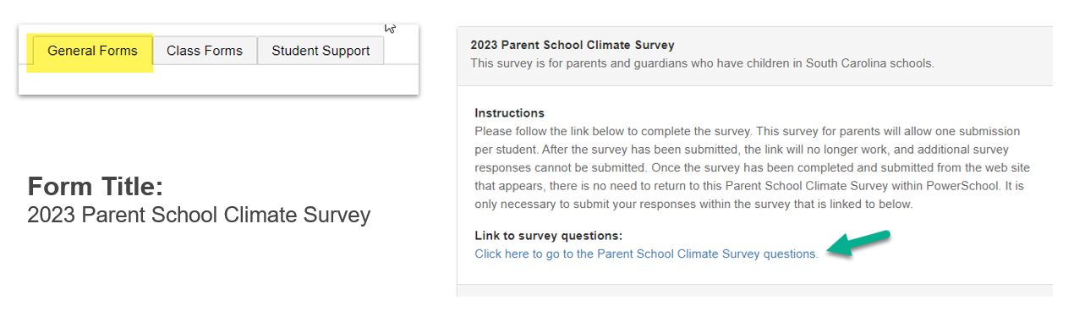
Parent Survey Links - Access through Parent Portal 3

Slide 8

Student and Teacher Surveys
Delivered and submitted through Ecollect during the survey administration window.
Surveys will be released directly to student and teacher respondents to complete and submit through an Ecollect Form accessible through Student Portal or Teacher Portal.
Please ensure that respondents completing the student and teacher surveys will have login access to Student Portal (for student surveys) and Teacher Portal (for teacher surveys).

Slide 9
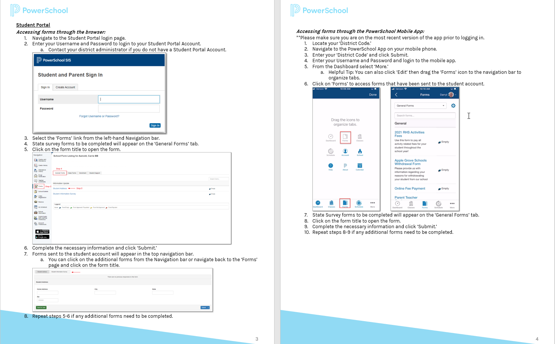
Student Survey - Access Through Student Portal 1
Please see the Accessing Ecollect Forms document linked to from the SCDE
Climate Surveys & Ecollect Forms web page for instructions on how student respondents can access their respective School Climate surveys.
Note that URLs for accessing PowerSchool portals (i.e., the PowerSchool Parent/Student Portal and Teacher Portal) vary from district to district.
Typically, in place of the word “admin,” Parent/Student Portal URLs include either the word “public” or “guardian,” and the word “teachers” is typically present in the case of Teacher Portal URLs.

Slide 10
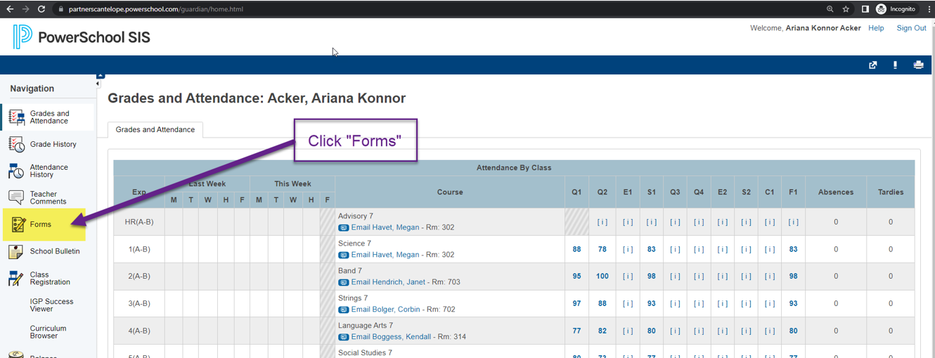
Student Survey - Access Through Student Portal 2

Slide 11
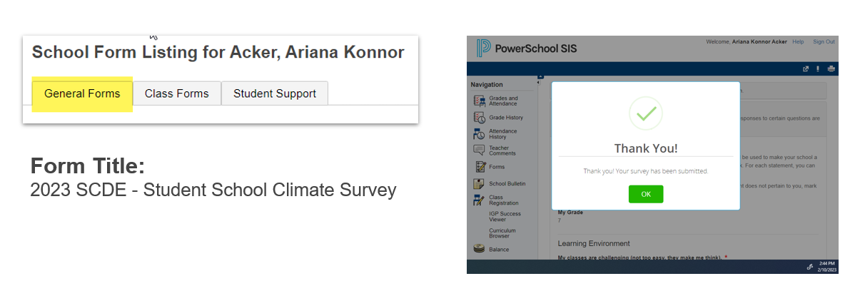
Student Survey - Access Through Student Portal 3

Slide 12
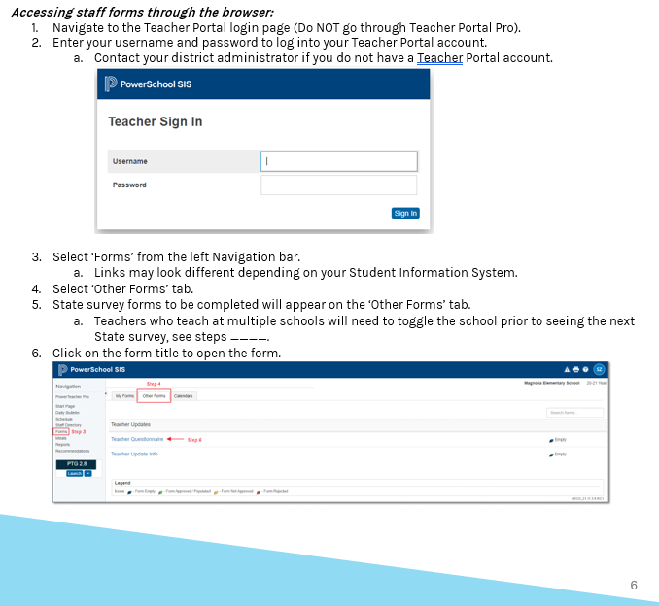
Teacher Survey - Access Through Teacher Portal
Please see the Accessing Ecollect Forms document linked to from the SCDE
Climate Surveys & Ecollect Forms web page for instructions on how teacher respondents can access their respective School Climate surveys.
Note that URLs for accessing PowerSchool portals (i.e., the PowerSchool Parent/Student Portal and Teacher Portal) vary from district to district.
Typically, in place of the word “admin,” Parent/Student Portal URLs include either the word “public” or “guardian,” and the word “teachers” is typically present in the case of Teacher Portal URLs.

Slide 13
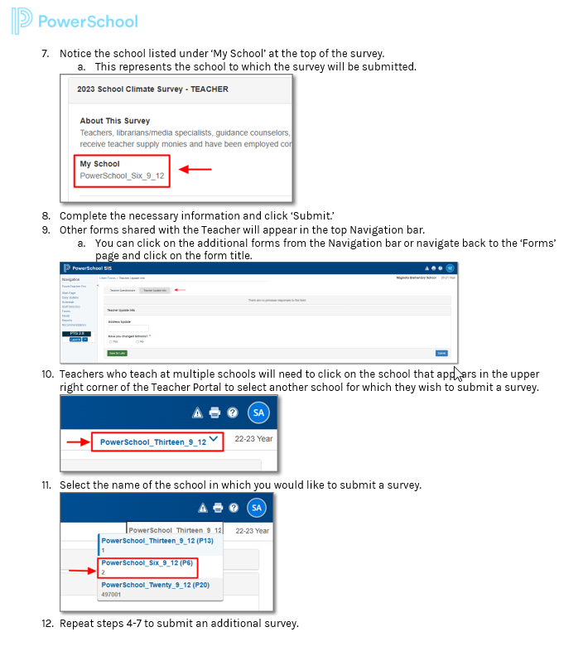
Teacher Survey - Access Through Teacher Portal 1
Please see the Accessing Ecollect Forms document linked to from the SCDE
Climate Surveys & Ecollect Forms web page for instructions on how teacher respondents can access their respective School Climate surveys.
Note that URLs for accessing PowerSchool portals (i.e., the PowerSchool Parent/Student Portal and Teacher Portal) vary from district to district.
Typically, in place of the word “admin,” Parent/Student Portal URLs include either the word “public” or “guardian,” and the word “teachers” is typically present in the case of Teacher Portal URLs.

Slide 14
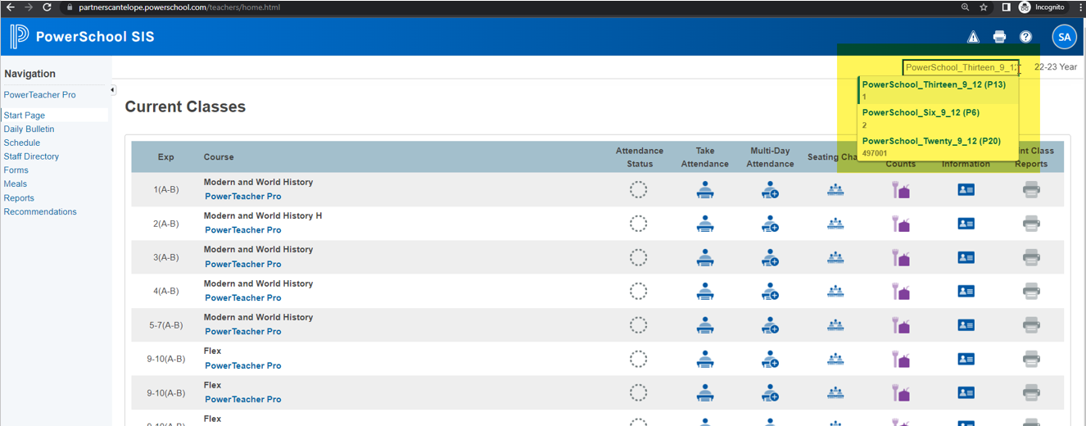
Teacher Survey - Access Through Teacher Portal 2

Slide 15
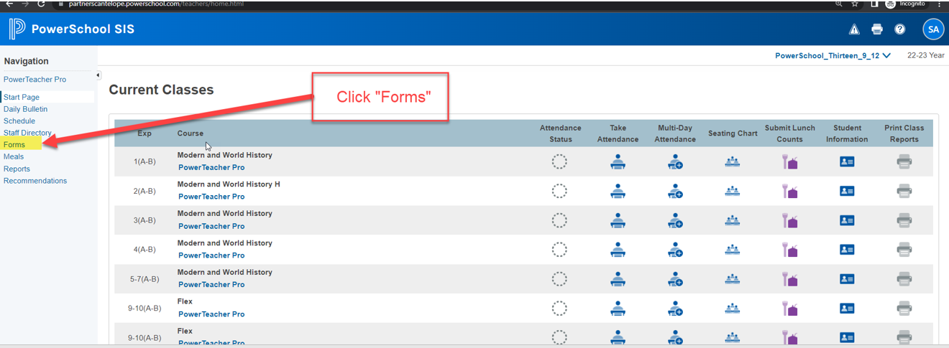
Teacher Survey - Access Through Teacher Portal 3

Slide 16
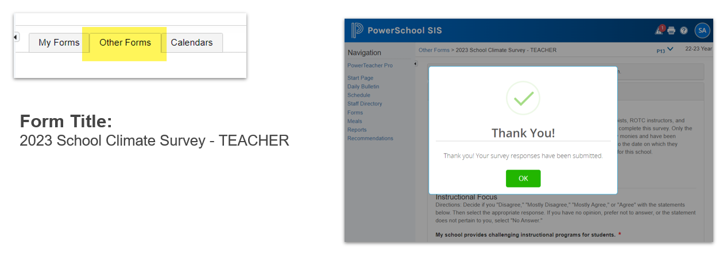
Teacher Survey - Access Through Teacher Portal 4

Slide 17
Self-Hosted Districts
IMPORTANT:
Self-hosted districts will know who they are!
For everyone else (the vast majority of our districts), this slide does not apply, as for PowerSchool-hosted districts, surveys will be delivered directly to parent, student, and teacher portals without any need for a meeting with PowerSchool.
PowerSchool has set up a password-protected, secure site for each self-hosted district from which they will download the surveys and install them.
PowerSchool will meet with each of these districts to make sure their installations and survey imports are completed correctly.

