Slide 1
            Grants Accounting and GAPS
Title I Coordinators Need Grant Coordinator Role for GAPS
- Regardless of whether they are the individual entering budget or not
  Quarterly Expenditure Reporting Required
  - Due by end of month following end of quarter once budget has been approved
  - If these aren’t submitted timely, risk assessment score will go up
Budget amendments must be submitted prior to expenditures being obligated – federal regulations state that expenditures
must be approved prior to obligation. If not, you’re out of federal compliance.
  - Please Note. General deadline for budget amendments is three weeks prior to
  end of expenditure period unless noted differently in GAN.

Slide 2
  Grants Accounting and GAPS (continued)
  Note…
  Final submission deadline for June 30, 20XX Expenditures
  will always be August 15, 20XX regardless of the award
  period of the grant and/or the day of the week that this
  date falls on.
  Please Review reports to verify that all line items have been submitted
  to SCDE Finance – items can’t be in Presubmittal or Submitted to Finance
  Approver Status. If they are, they haven’t been submitted to the SCDE
  for payment and will not be paid.

Slide 3
GAPS Reports Available
Two Types of Reports Available
Budget
Budget Summary – High level report to show budget balance
* Budget Details – Budget Balance by line item and Approval Status
Budget Status – Summary report – probably not useful for you
* Budget Actuals Summary – Budget balance/pending items
Expenditures
Expenditure Summary – High level report to show net funds remaining
*Expenditure Details – Line item expenditures report and Approval Status
Expenditure Status – Summary report – probably not useful for you
Expenditure Refund Details – To view status of Expenditure Refunds
Additional Tips.
Reports can be sorted by clicking on column headings if needed
Most reports can be exported to EXCEL for further sorting and/or filtering

Slide 4
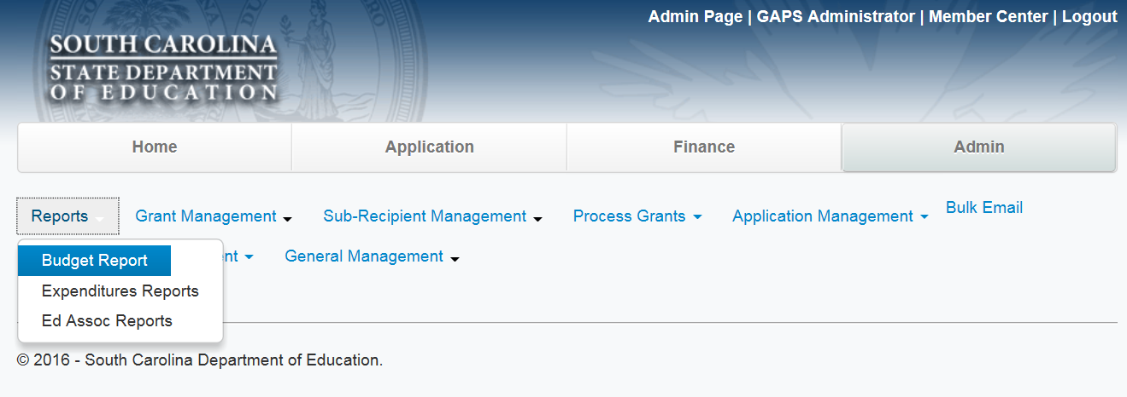
Accessing Reports in GAPS
To view Budget Status
3) Select Budget Report
Your screen will look a little different. However, you will choose the
Admin Tab and then Go To
Reports Tab

Slide 5
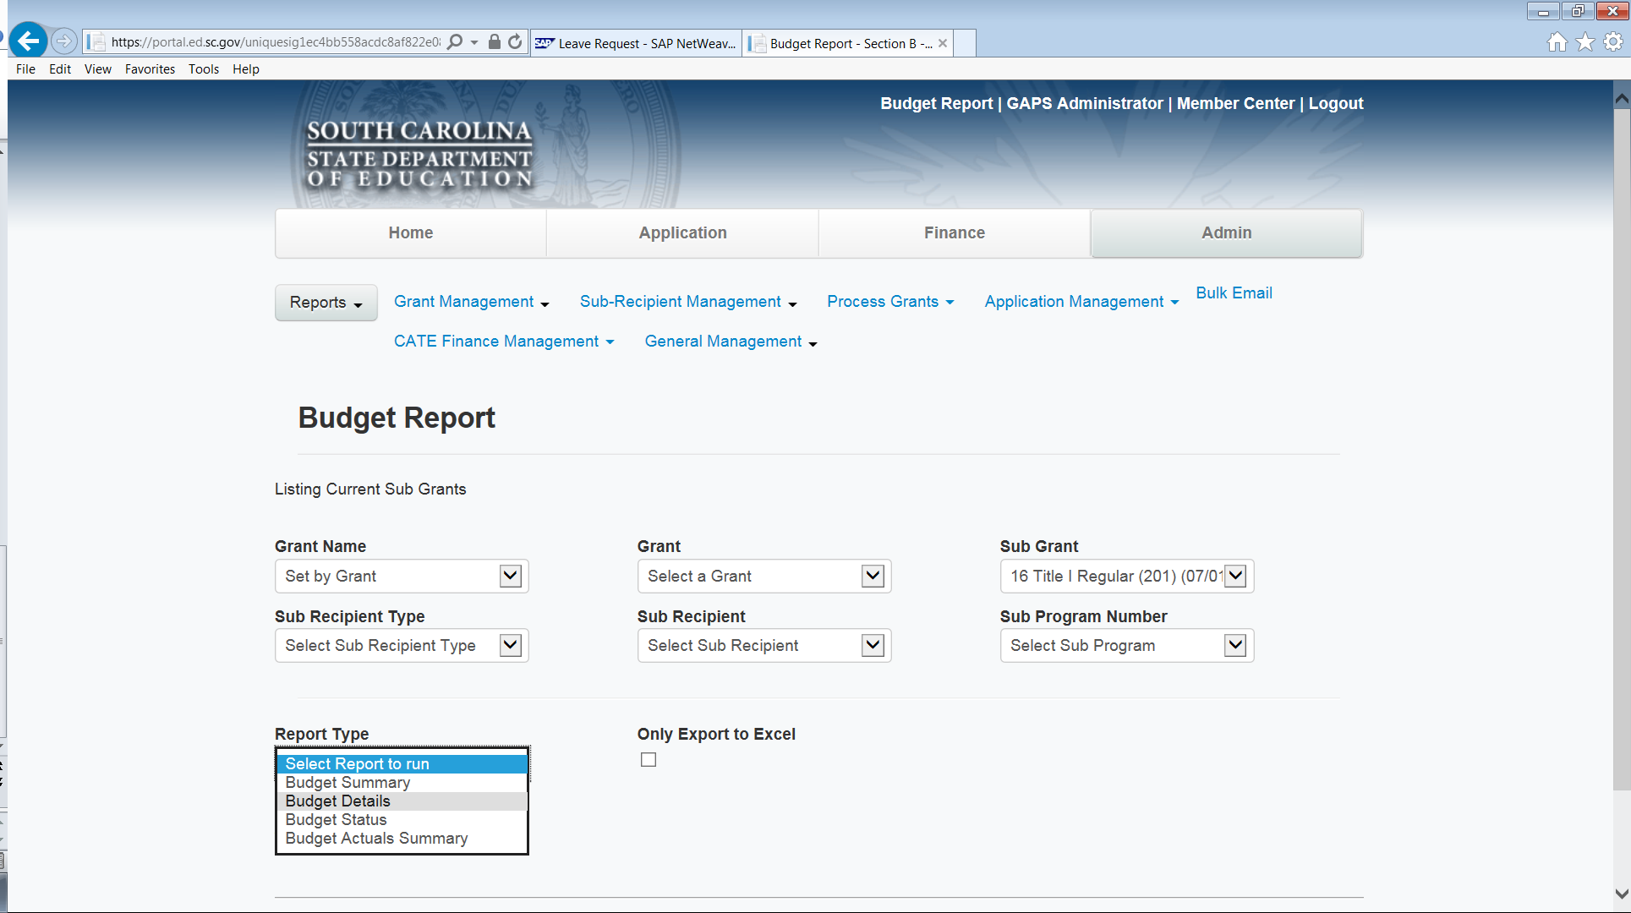
Accessing Reports in GAPS (cont’d)
To check status of a budget

Slide 6
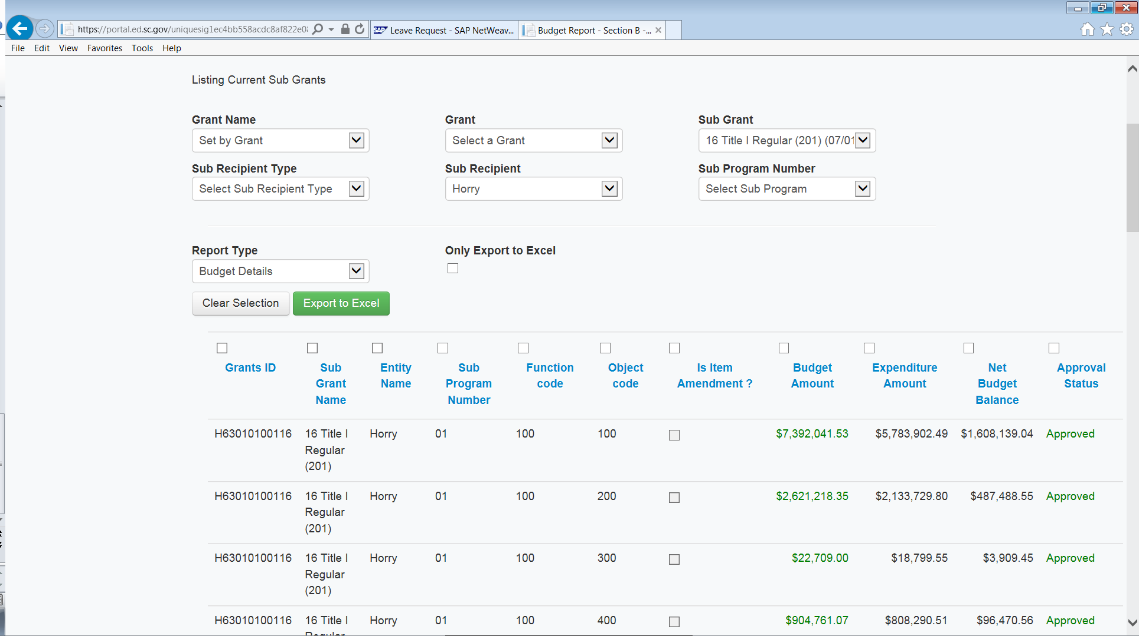
Accessing Reports in GAPS (cont’d)
Select Sub
Grant Title
Select Budget Details to see approval status by line

Slide 7
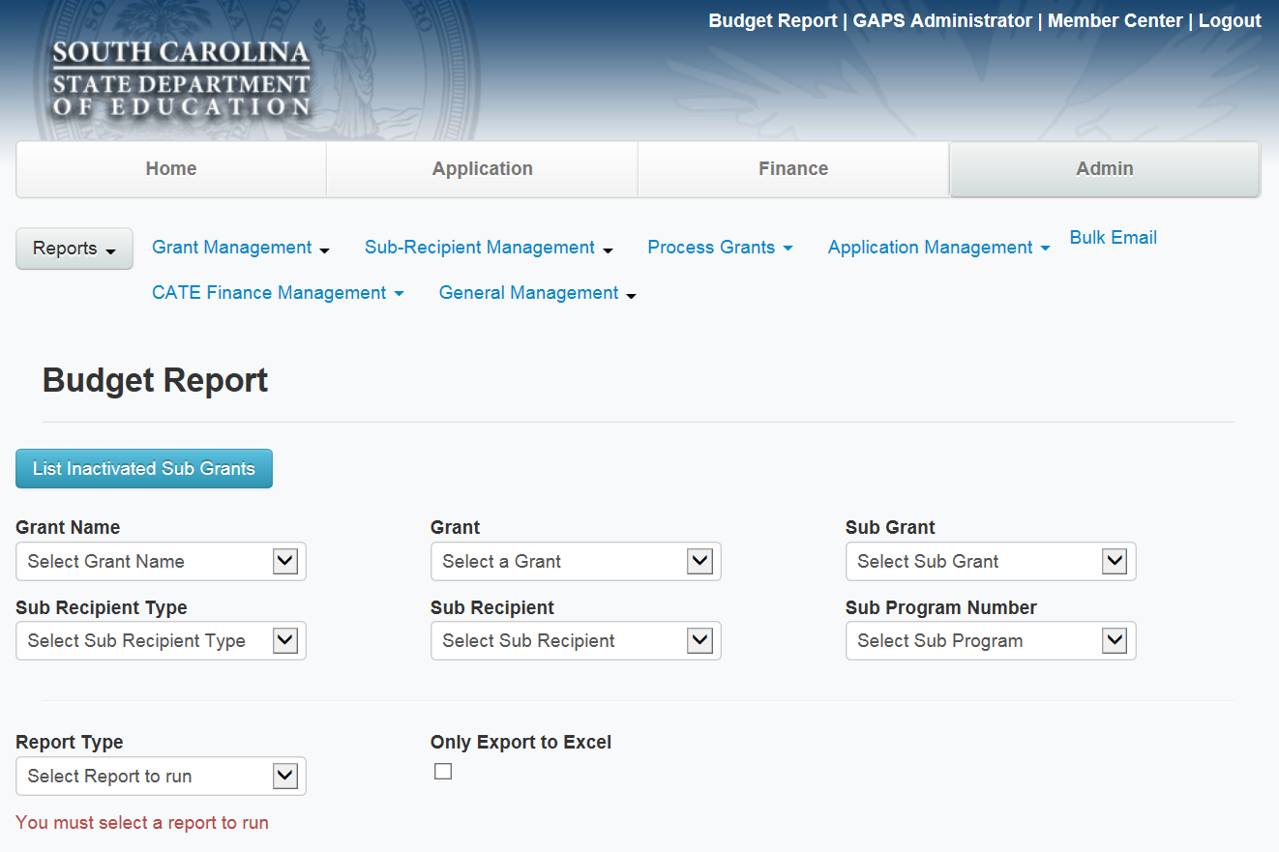
Accessing Reports in GAPS (cont’d)
For Budget Reports, you’ll have to click on the
Button for Inactivated Sub grants if the grant is no longer in an active award status

Slide 8
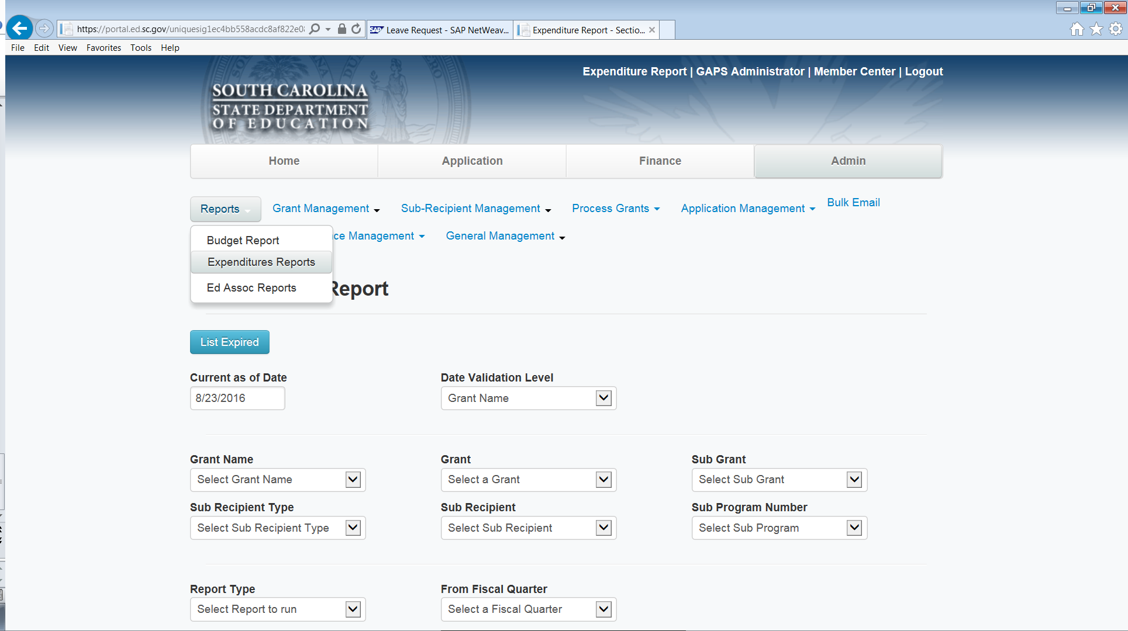
Accessing Reports in GAPS (cont’d)
Expenditure reports are accessed by going back to Reports Tab

Slide 9
FUTURE QUESTIONS/ISSUES
Questions related to Budget/Budget Amendment Status need to go to the specific SCDE Program Office – Grants Accounting Staff can’t approve or return these items
Questions related to Expenditures/Expenditures Refunds Status need to be sent to the SCDE Grants Accounting Office at grantsaccounting@ed.sc.gov.
GAPS issues should be explained and screenshots taken of each step being taken and sent to the Grants Accounting Office at grantsaccounting@ed.sc.gov
You’re always welcome to copy the assigned Grants Accountant on these email submissions. However, the grants email box is monitored all day and chances are you’ll hear back from someone more quickly when your question is submitted through this box. Also, this allows us to maintain a tracking system so we can watch for potential issues affecting multiple users so we can begin trouble shooting the issue.

